Slide 1

NLP and Transformers: L3: Transformers and Self-Attention
Jay Urbain, PhD
jay.urbain@gmail.com
https://www.linkedin.com/in/jayurbain/
https://github.com/jayurbain
March 2022

Slide 2
Revolution in NLP - Attention Is All You Need
bert-qa-x1 – BERT QA
http://35.239.172.96:8080/
Bio NER + Entity Linking - scispacy-umls-entity
http://34.136.131.39:8000/
01_transformer_hg_intro.ipynb
https://colab.research.google.com/drive/1SSSPQbQo73FA1Qg91Rh9WLvucbEuWVNJ#scrollTo=lUfVLI9ZCZIu
GPT3 – SQL
http://localhost:8888/notebooks/OpenAI-GPT3-2021/gpt-3-simple-tutorial/gpt-3-notebook.ipynb
CLIP with GPT3
https://colab.research.google.com/github/openai/glide-text2im/blob/main/notebooks/text2im.ipynb#scrollTo=zj6znj2k2iAu

Slide 3
Revolution in NLP - Attention Is All You Need
The transformer is a neural network architecture proposed in 2017 in a groundbreaking paper called “Attention Is All You Need”, by Google.
Combines self-supervised pre-training on very large datasets with a scalable attention-based architecture.
Crushed performance of previous architectures that were typically based on recurrent neural networks (RNNs).
The Transformer architecture is excellent at capturing patterns in long sequences of data and dealing with huge datasets.

Slide 4
Transformers
Google now uses BERT to enhance its search engine results by better understanding users’ search queries.
BERT consistently places at the top of leader boards for named entity recognition, question-answering, and summarization.
Google uses T5 for language translation.
GPT family of models from OpenAI have repeatedly made headlines for their ability to generate human-like text, images, code, and chemistry.

Slide 5
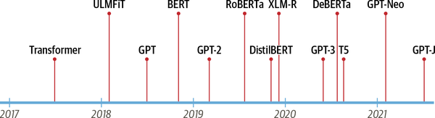
Hello Transformers
Catalysts for two of today’s most well-known transformers: the Generative Pretrained Transformer (GPT) and Bidirectional Encoder Representations from Transformers (BERT).

Slide 6
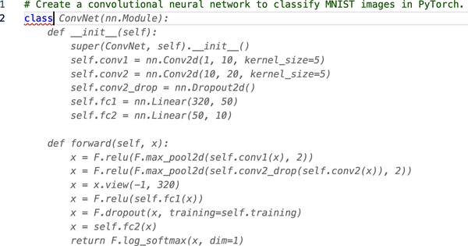
Code generation with GPT
Transformers power applications like GitHub’s Copilot, which can convert a comment into source code

Slide 7
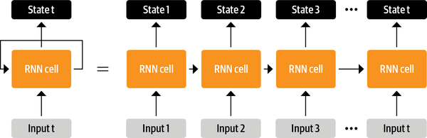
Recurrent Neural Network (RNN)
Prior to transformers, recurrent architectures such as LSTMs were the state of the art in NLP.
RNN passes information about its state at each step to the next operation in the sequence. Allows an RNN to keep track of information from previous steps.
Andrej Karpathy’s blog post, “The Unreasonable Effectiveness of Recurrent Neural Networks”.

Slide 8
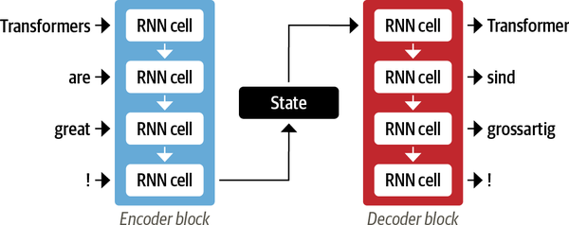
RNN Encoder-Decoder
Input words are fed sequentially through the encoder and the output words are generated one at a time, from top to bottom.
Final hidden state of the encoder creates an information bottleneck: it has to represent the meaning of the whole input sequence.
Notes:
Vanishing gradient

Slide 9
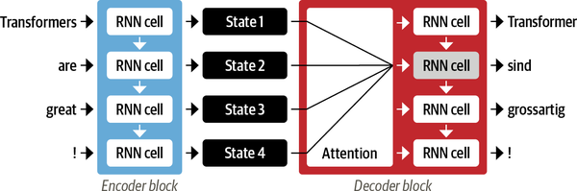
Attention Mechanisms
Instead of producing a single hidden state for the input sequence, the encoder outputs a hidden state at each step that the decoder can access.
Allows decoder assign a different weight or “attention” to each of the encoder states at every decoding steep.
Notes:
Weights assigned dynamically based on context.

Slide 10
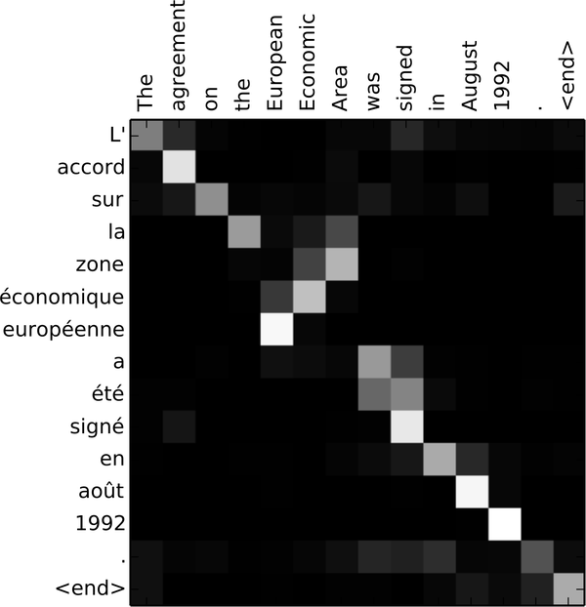
Attention
Focus on which input tokens are most relevant at each timestep.
Attention-based models learn nontrivial alignments between the words
Notes:
Wegihts assigned dynamically based on context.

Slide 11
RNNs + Attention
Enabled better translations, but: computations are inherently sequential and could not be parallelized across the input sequence.
Limits scalability.
With the transformer, a new modeling paradigm was introduced: dispense with recurrence altogether, and instead rely entirely on a special form of attention called self-attention.
Notes:
Wegihts assigned dynamically based on context.

Slide 12
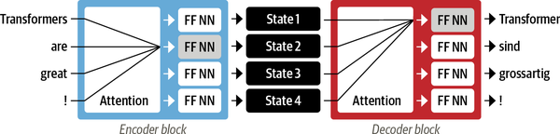
Transformer Attention
Allow attention to operate on all the states in the same layer of the network.
Both the encoder and the decoder have their own self-attention mechanisms, whose outputs are fed to feed-forward neural networks (FF NNs).
Much faster than recurrent models and paved the way for many of the recent breakthroughs in NLP.
Notes:
Wegihts assigned dynamically based on context.

Slide 13
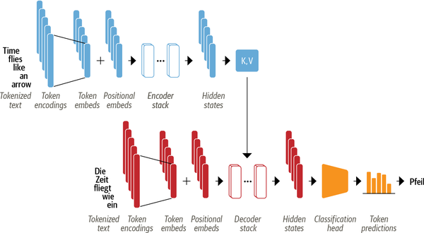
Encoder-Decoder of Transformer
Encoder and decoder are composed of several building blocks.
Notes:
The input text is tokenized and converted to token embeddings.
The token embeddings are thus combined with positional embeddings that contain positional information for each token.
The encoder is composed of a stack of encoder layers or “blocks,”
The same is true of the decoder, which has its own stack of decoder layers.
The encoder’s output is fed to each decoder layer, and the decoder then generates a prediction for the most probable next token in the sequence.
The output of this step is then fed back into the decoder to generate the next token, and so on until a special end-of-sequence (EOS) token is reached.
Imagine the decoder has already predicted “Die” and “Zeit”. Now it gets these two as an input as well as all the encoder’s outputs to predict the next token, “fliegt”.
In the next step the decoder gets “fliegt” as an additional input. We repeat the process until the decoder predicts the EOS token or we reached a maximum length.

Slide 14
Transformer

Slide 15
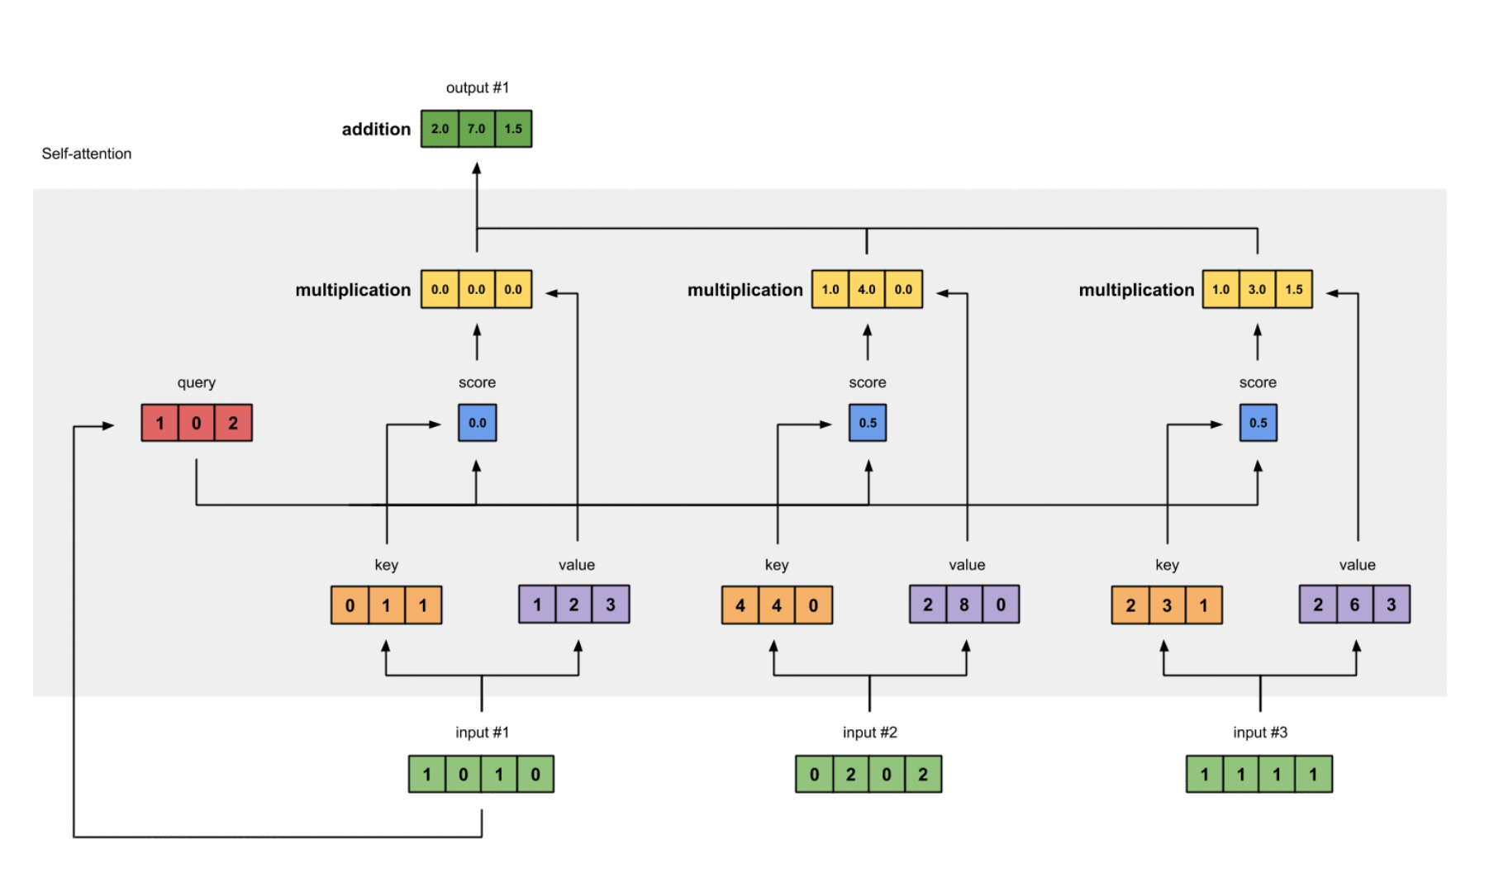
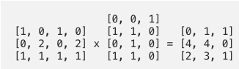
Transformer
keys
Notes:
https://towardsdatascience.com/illustrated-self-attention-2d627e33b20a

Slide 16
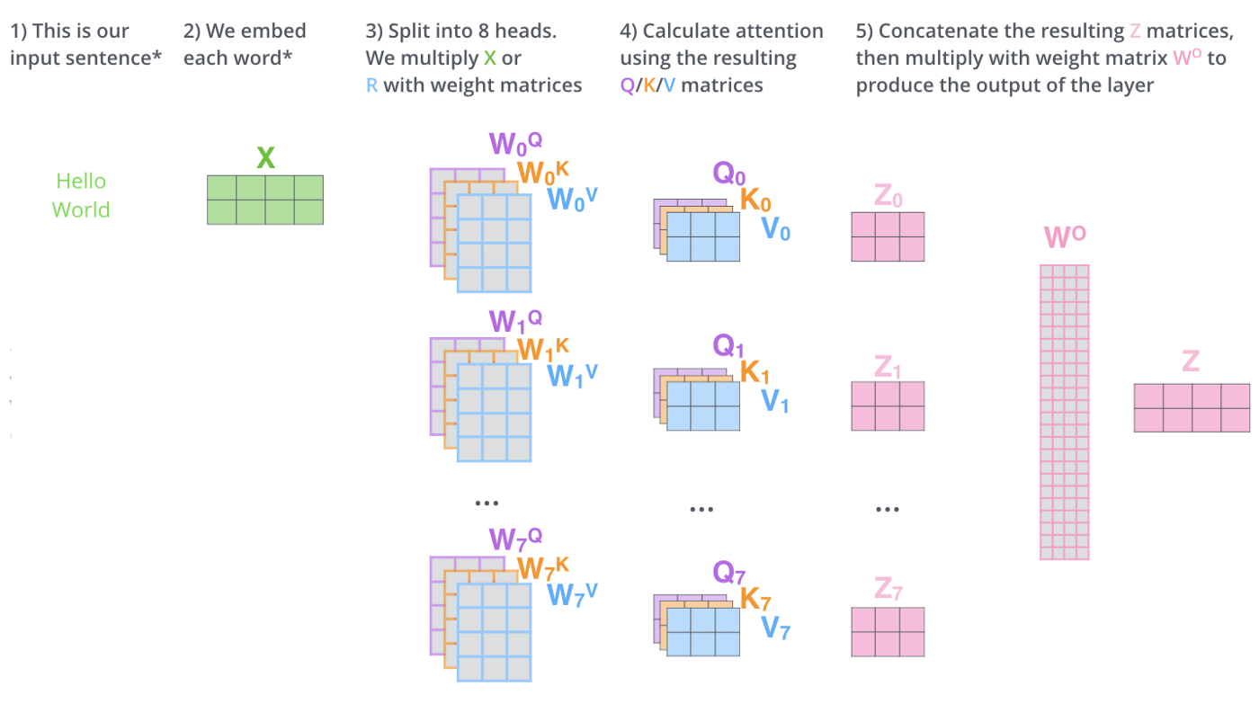
Transformer

Slide 17
Transfer Learning in NLP
Allow network to make use of the knowledge learned from a more general learning task.
General network often trained on a much later data set.
Architecturally, involves splitting the model into a body and a head. The head is a task-specific network.
During training, the weights of the body learn broad features of the source domain. These weights are used to initialize a new model for the new task.
Compared to traditional supervised learning, this approach typically produces high-quality models that can be trained much more efficiently on a variety of downstream tasks, and with much less labeled data.
Notes:
Wegihts assigned dynamically based on context.

Slide 18
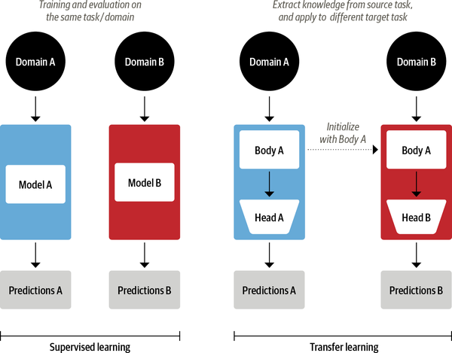
Transfer Learning in NLP
Notes:
Wegihts assigned dynamically based on context.

Slide 19
Revolution in NLP – Model Pretraining & Transfer Learning
Pretraining has been mainstream in image processing since the early 2010s, but in NLP it was restricted to contextless word embeddings (i.e., dense vector representations of individual words).
For example, the word “bear” had the same pretrained embedding in “teddy bear” and in “to bear.”
In 2018, several papers proposed full-blown language models that could be pretrained and fine-tuned for a variety of NLP tasks; this completely changed the game.

Slide 20
Revolution in NLP – Model Hubs
Model hubs like Hugging Face’s have also been a game-changer.
In the early days, pretrained models were just posted anywhere, so it wasn’t easy to find what you needed.
Hugging Face’s Transformers: it’s open source, it supports both TensorFlow and PyTorch, and it makes it easy to download a state-of-the-art pretrained model from the Hugging Face Hub, configure it for your task, fine-tune it on your dataset, and evaluate it.

Slide 21
Key concepts needed to understand transformer
The encoder-decoder framework
Attention mechanisms
Transfer learning

Slide 22
Transformer Anatomy
Encoder-decoder architecture
Sequence of words is translated from one language to another.
Encoder
Converts an input sequence of tokens into a sequence of embedding vectors, often called the hidden state or context
Decoder
Uses the encoder’s hidden state to iteratively generate an output sequence of tokens, one token at a time

Slide 23
Encoder Only Models
Text classification or named entity recognition.
BERT and its variants, like RoBERTa and DistilBERT..
The representation computed depends on the left (before the token) and the right (after the token) contexts.
Called bidirectional attention.
Notes:
In reality, the distinction between applications for decoder-only versus encoder-only architectures is a bit blurry.

Slide 24
Decoder Only Models
Given a prompt of text like “Thanks for lunch, I had a…” these models will auto-complete the sequence by iteratively predicting the most probable next word.
The family of GPT models belong to this class.
The representation computed for a given token in this architecture depends only on the left context.
This is often called causal or autoregressive attention.

Slide 25
Encoder-Decoder Models
Encoder-decoder
Original Transformer architecture.
Used for modeling complex mappings from one sequence of text to another.
Suitable for machine translation and summarization tasks.
In addition to the Transformer architecture, the BART and T5 models belong to this class.

Slide 26
The Encoder
Encoder-only
Text classification or named entity recognition. BERT and its variants, like RoBERTa and DistilBERT..
The representation computed depends on the left (before the token) and the right (after the token) contexts. Called bidirectional attention.
Decoder-only
Given a prompt of text like “Thanks for lunch, I had a…” these models will auto-complete the sequence by iteratively predicting the most probable next word.
The family of GPT models belong to this class. The representation computed for a given token in this architecture depends only on the left context. This is often called causal or autoregressive attention.
Notes:
the transformer’s encoder consists of many encoder layers stacked next to each other.
Each encoder layer receives a sequence of embeddings and feeds them through the following sublayers:
A multi-head self-attention layer
A fully connected feed-forward layer that is applied to each input embedding
The output embeddings of each encoder layer have the same size as the inputs.
The main role of the encoder stack is to “update” the input embeddings to produce representations that encode some contextual information in the sequence.
For example, the word “apple” will be updated to be more “company-like” and less “fruit-like” if the words “keynote” or “phone” are close to it.

Slide 27
Key concepts needed to understand transformer
The encoder-decoder framework
Attention mechanisms
Transfer learning

Slide 28
What is Natural Language Processing?
Why is NLP hard?
Core NLP Tasks
Applications
Deep Learning for NLP
Future Directions
TOPICS
I am convinced that the crux of the problem of learning is recognizing relationships and being able to use them.
-- Christopher Strachey in a letter to Alan Turing, 1954

Slide 29
WHAT IS NATURAL LANGUAGE PROCESSING (NLP)?

Slide 30
Automatic Writing
NLP TASKS
General Q&A
Intent Detection
Summary Generation
Common Sense Reasoning
Natural Language Processing
Word Sense
Auto Completion
Automatic Dialogue Generation
Translation
Sentiment Analysis
Code Generation
And many more….

Slide 31
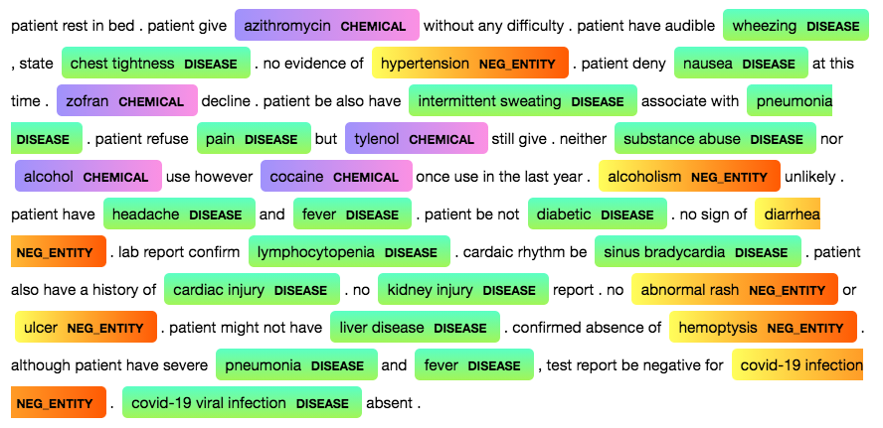

NATURAL LANGUAGE PROCESSING (NLP)
Goal: for computers to process and “understand” natural language.
Add structure and meaning to unstructured text in order to make text “computational.” Perform useful tasks:
Question answering, information extraction, language translation, summarization, search.
http://localhost:8888/notebooks/NLP_KG_2021/Scispacy_NE.ipynb
Notes:
Natural language processing is a field at the intersection of:
Computer Science
Artificial Intelligence
Linguistics

Slide 32


Scientific Goals: Natural language Processing
Human language is constructed to convey meaning.
Provides insight into human cognition.
Highly efficient, dynamic signaling system. Adapts to context.
Mostly a discrete categorical system (concept, attributes, relations):
rocket = violin =
Solve a major problem in AI
Understanding and representing the full meaning of language is unsolved.

Slide 33
WHY IS NLP HARD? … and why Deep Learning may help

Slide 34


Language: the ultimate UI
Where is A Bug’s Life playing in Milwaukee?
A Bug’s Life is playing at the Downer Theater.
When is it playing there?
It’s playing at 2pm, 5pm, and 8pm.
OK. I’d like 1 adult and 2 children for the first show.
How much would that cost?
But we need domain knowledge, discourse knowledge, world knowledge
Notes:
After all, language is really the ultimate user interface – well, maybe not for all applications, maybe not for Photoshop.
But wouldn’t it be incredibly useful if you could have an interaction like this?
But this is well beyond what we can do today. Take a moment to consider what makes this hard.
Let me focus just on the problem of reference resolution – figuring out what various expressions refer to.
We need to recognize that “A Bug’s Life” refers to a movie, and “Milwaukee” refers to a town.
We need to figure out that “it” refers to “A Bug’s Life”, “there” refers to “the Downer Theater”, and “that” refers to the tickets.
And we need to understand that people don’t generally buy adults and children, and therefore that the user is referring to buying adult and child tickets.
We also need to figure out that “the first show” refers to 2pm, because 2pm is earlier than 5pm and 8pm.
And that’s just for reference resolution. So this is really quite challenging. [>]
Domain knowledge – Bug’s life is a movie, Milwaukee is a city
Discourse – the meaning of language within a context, e.g., knowing how a conversation fits together
World knowledge – the knowledge that we already have and can draw on in a conversation

Slide 35

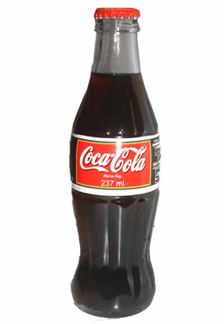


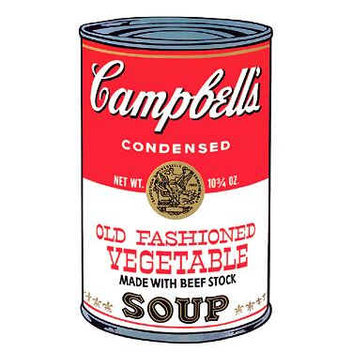
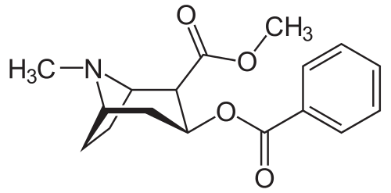
Meanings and expressions
Big obstacle: relation between meanings and expressions is not one-to-one
soda
Biebster
soft drink
pop
beverage
Coke
Many expressions, many meanings …
Notes:
One big obstacle is that the relation between meanings and expressions is not one-to-one. Far from it.
First, one meaning can be expressed in many different ways – so this thing can be described as “soda”, or a “soft drink”, or “pop”.
And conversely, one expression can have many different meanings – so “pop” can refer to the Biebster, or your Dad, or even Pop Art. [>]

Slide 36
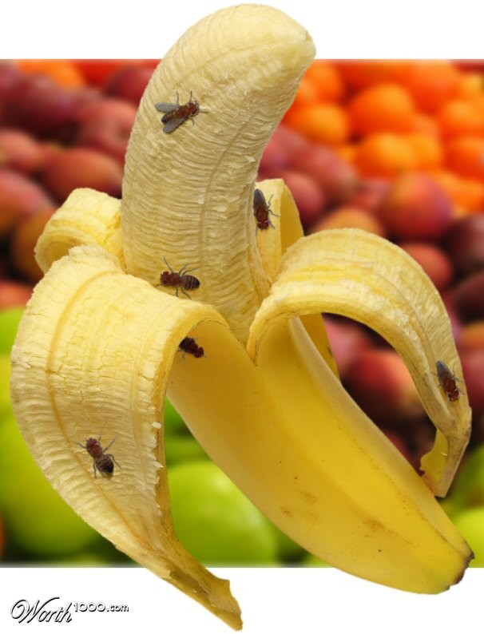
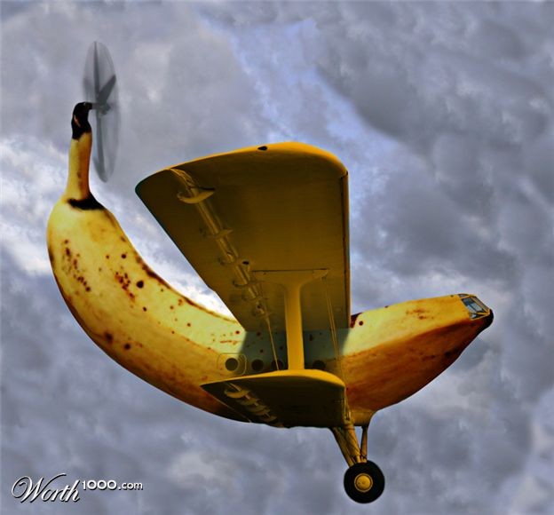
Syntactic & semantic ambiguity
syntactic ambiguity
S
S
VP
VP
semantic ambiguity
PP
NP NP
NP NP
Fruit flies like a banana
Fruit flies like a banana
[“like” is a remarkable word: it can be used as a noun, verb, adverb,
adjective, preposition, particle, conjunction, or interjection.]
photos from worth1000.com
Notes:
So we have two possible readings, represented here pictorially. And we have two different kinds of ambiguity.
First, there is semantic ambiguity.
“Flies” could be a noun, meaning insects, or it could be a verb, meaning travel by air.
And “like” could be a verb, meaning love, or it could be a preposition, meaning similar to.
[“like” is a remarkable word: it can be used as a noun, verb, adverb, adjective, preposition, particle, conjunction, or interjection.]
And then we also have a syntactic ambiguity.
It could be that “fruit flies” is the subject, and “like a banana” is the predicate.
Or it could be that “fruit” is the subject, and “flies like a banana” is the predicate.
These kind of ambiguities show up all over the place, and as humans, we’re so good at resolving them that usually we don’t even notice them consciously.
But sometimes, unintentional ambiguities produce a quite comic effect. [>]

Slide 37
Capturing context and semantics
General concepts –
Protein, gene, expression, or disease, take on a more specific meaning when coupled with contextual information about a topic.
protein + chronic wasting disease => prion protein.
progression + neoplasm => tumor progression.

Slide 38
Capturing context and semantics
Ambiguous terms –
TREC query: How to "open up cell through "electroporation," only one distinct concept: electroporation, as the acronym EPT, was identified.
Which passage is relevant?
Passage 1: …malignant potential among endocrine pancreatic tumors (EPTs) varies greatly and can frequently not be predicted using histopathological parameters…
Passage 2: … EPT which uses pulsed electric fields in combination with a chemotherapeutic agent is being developed to treat human pancreatic tumors…
Notes:
Identifying concepts solely by term matching fails to disambiguate polysemous terms.

Slide 39
Capturing context and semantics
Term mismatch –
TREC query: What serum [proteins] change in association with high disease activity in lupus?
How to identify SLE as lupus, sera as pl. form of serum?
Passage: … SLE sera were used. The most marked nuclear staining occurred with sera from patients with active disease…
Need to capture contextual dependencies between terms.
Notes:
Provides no weight to potentially relevant passages that do not contain specific term instances.

Slide 40
Example: Medical Records Structure/Grammar
Echo/MUGA: Echo (EF 0 . 53, Mild MR, Mild TR) [9_13_2009] Echo (EF 0 . 48, Mild TR, Mild MR) [10_10_2010] Echo (EF 0 . 50, mild MR and TR) [4_2_2012] Echo (EF 0 . 56, mild MR and TR, mild [LOCATION]) DEE [4_8_14]
Echo/MUGA: Echo (EF 0 . 64, Mild LVH, Mild TR, Mild AR, Moderate MR, Moderate Pulmonary HTN, Mild RAE, Pseudo Normal Diastolic Dysfunction, Mild LAE) [11_17_2011] TEE (EF 0 . 70, Moderate LAE, Mild Moderate MR, Mild PR, Mild LVH, Mild AR, Mild RAE, Mild TR, Prominent, thickened, Ca++ Eustachian valve . No intracardiac mass . ) [5_18_2012] Echo ( [7_12_2013] ): Normal LV size . EF = 60% . Normal RV size and function . Mild AI, mild to moderate MR, mild TR . RVSP = 32 Echo [7_18_14] : There is mild concentric left ventricular hypertrophy . LVEF based on [PERSON] [PERSON]'s method is 56% . Left ventricle is normal size with normal systolic function . The left atrium is mildly enlarged based on estimated volume . There is moderate diastolic dysfunction present . The right ventricle is normal size with normal systolic function . Normal wall thickness . There is mild to moderate mitral regurgitation . There is mild tricuspid regurgitation . Compared to previous echo dated [7_12_2014] , AR is no longer appreciated . Electrophysiology: EKG (Sinus Rhythm, Normal EKG) performed by [PERSON] [PERSON] [PERSON] MD [5_5_2012]

Slide 41
Open Source NLP Tools
Opensource NLP tools provide functionality for extracting NLP features from text to build apps:
SpaCy
NLTK
StanfordNLP
OpenNLP
Deep learning libraries for building SOTA models:
PyTorch
Tensorflow

Slide 42
CORE NLP TASKS

Slide 43
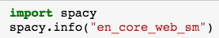
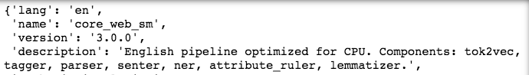
Core Tasks for NLP Features
Tokenization
Part-of-speech tagging
Noun chunking
Lemmatization, stemming
Morphology
Parsing
Named entity classification
Information extraction
Load model "en_core_web_sm" processing pipeline.

Slide 44
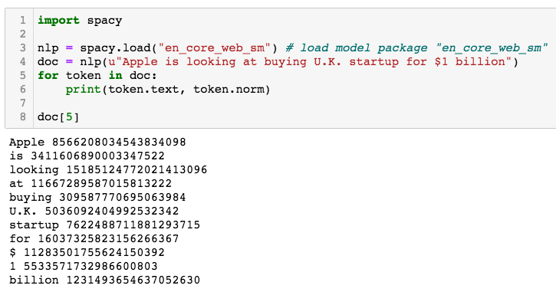
Tokenization
When we process a sentence through the pipeline, spaCy creates a document (Doc) object.
The Doc object lets you access information about the text in a structured way from each model in the pipeline
Notes:
Note: word vectors

Slide 45
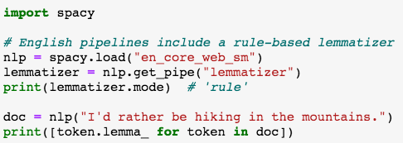
Lemmatization
Root word form.
Helpful for reducing vocabulary size,
word matching, and search.

Slide 46
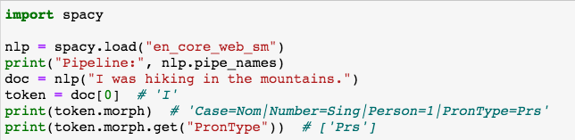
Morphology
Helpful for POS, noun chunking and NER.

Slide 47
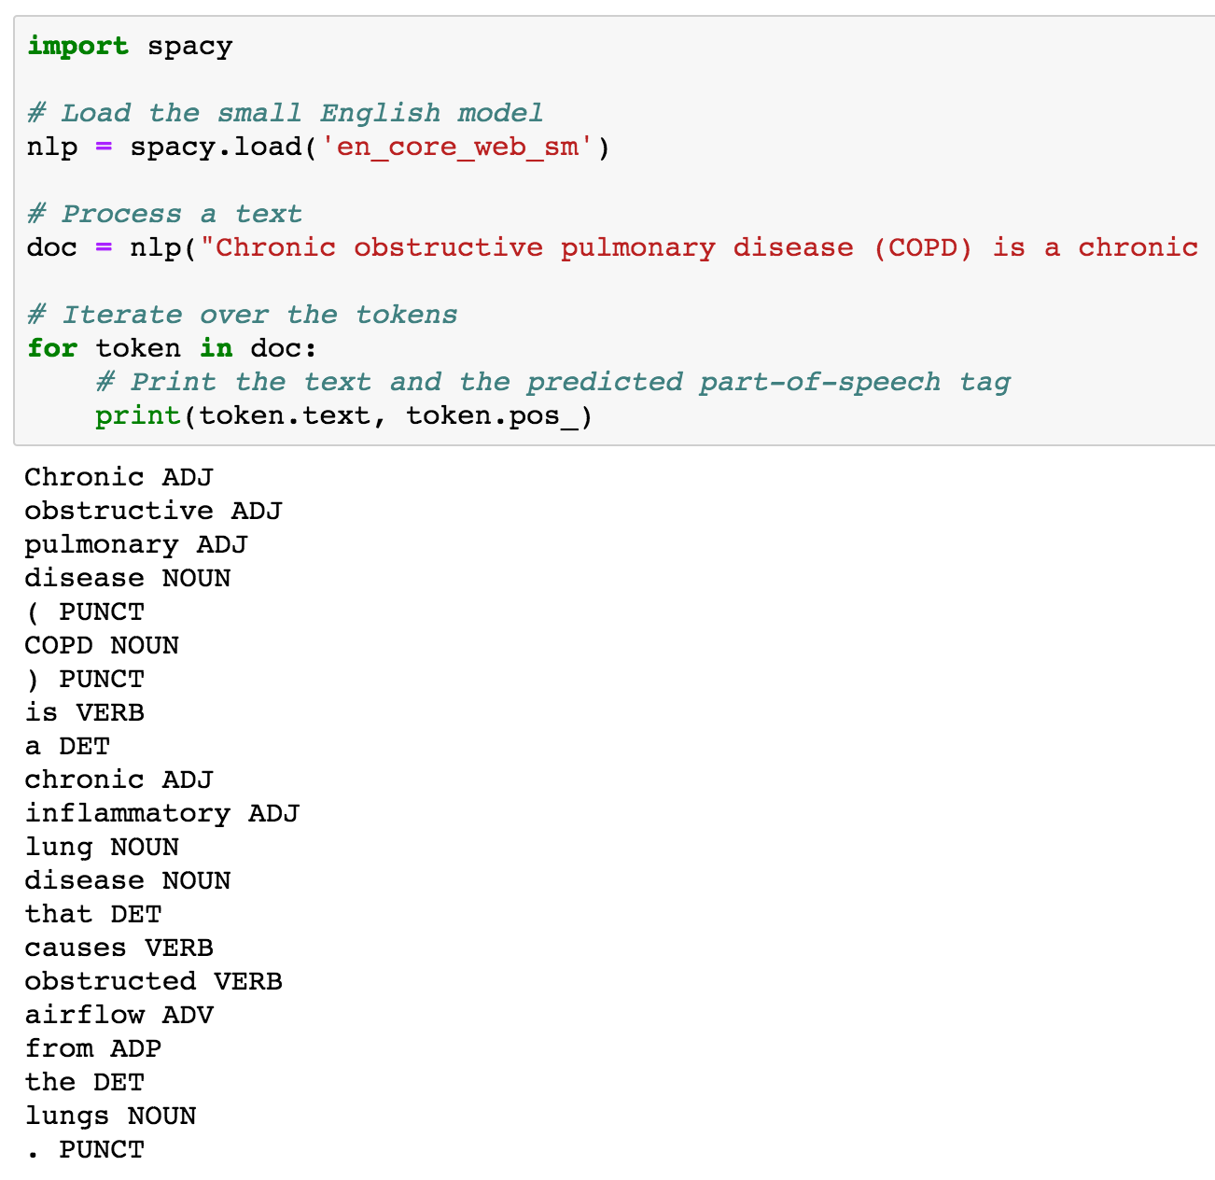
Part-Of-Speech Tagging (POS)
Statistical ML models allow you to predict linguistic attributes in context:
Part-of-speech tags
Noun chunking
Syntactic dependencies
Named entities
Models are trained on labeled example texts and can be updated with more examples to fine-tune predictions.

Slide 48
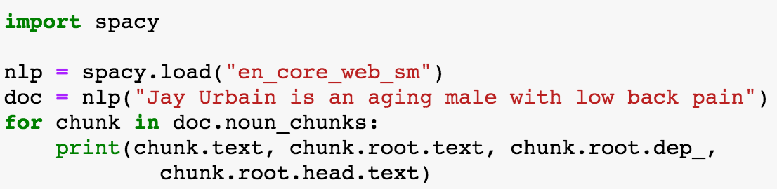
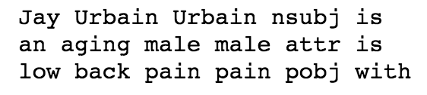
Noun Chunking
Helpful for NER, triple identification (subject, predicate, object).

Slide 49
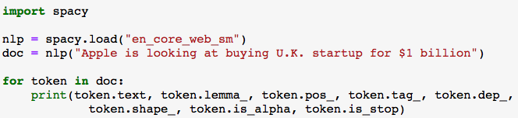
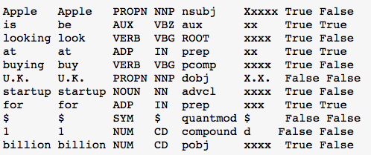
Core NLP Features
Lemma
POS
Tag
Dep
Shape
alpha
stop
Text: The original word text.
Lemma: The base form of the word.
POS: The simple UPOS part-of-speech tag.
Tag: The detailed part-of-speech tag.
Dep: Syntactic dependency, relation
between tokens.
Shape: Capitalization, punctuation, digits.
is alpha: Is the token an alpha character?
is stop: Is the token part of a stop list?

Slide 50
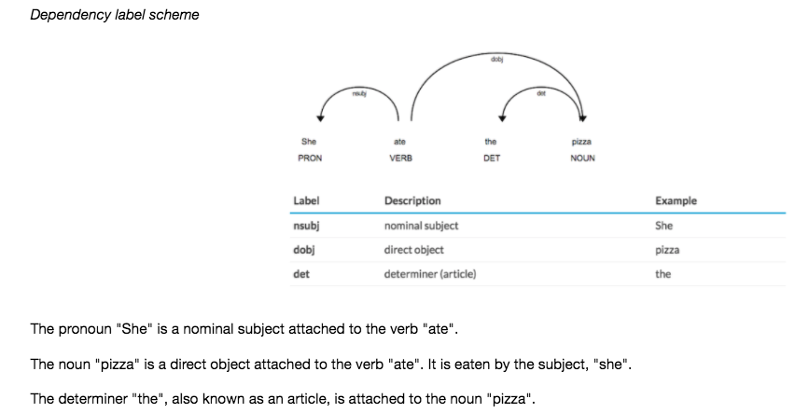
Syntactic dependency, relation between tokens
Notes:
Dependency parsing is the task of extracting a dependency parse of a sentence that represents its grammatical structure and defines the relationships between “head” words and words, which modify those heads.

Slide 51
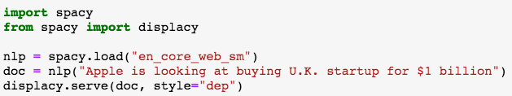
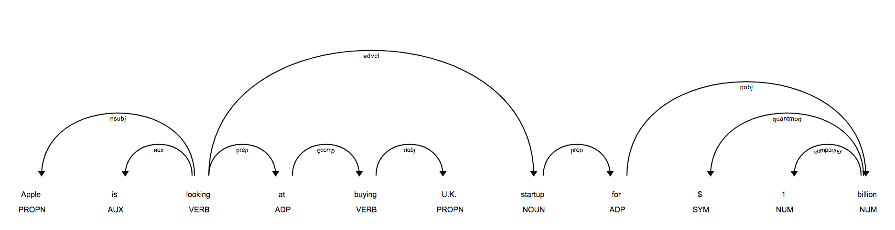
Syntactic dependency, relation between tokens
Helpful for information extraction
Identify (subject, predicate, object)
Entity and it’s attributes
Sentence boundary detection
Iterate over noun phrases “chunks”

Slide 52
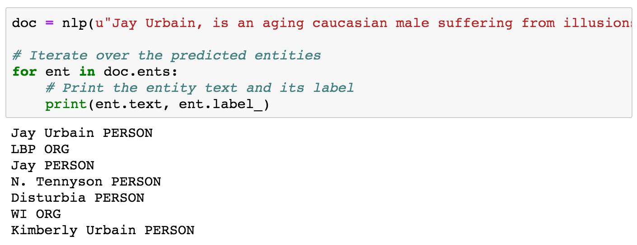
Named Entity Recognition
Identify real world object, for example, person, place, organization, etc.
Notes:
Machine learning methods:
Statistical machine learning model – Conditional Random Field
SOTA – Deep learning Transformer Model – “BERT”

Slide 53
Entity Negation - NegEx
Import to rule-in/rule-out medical concepts.
NegEx – rule-based algorithm, use with named entity model.
http://localhost:8888/notebooks/NLP_KG_2021/Scispacy_NE.ipynb
Notes:
Machine learning methods:
Statistical machine learning model – Conditional Random Field
SOTA – Deep learning Transformer Model – “BERT”

Slide 54
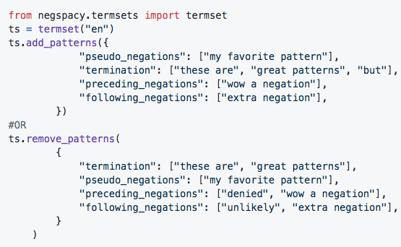
Entity Negation - NegEx
NegEx Patterns
psuedo_negations - phrases that are false triggers, ambiguous negations, or double negatives
preceding_negations - negation phrases that precede an entity
following_negations - negation phrases that follow an entity
termination - phrases that cut a sentence in parts, for purposes of negation detection (.e.g., "but")
Notes:
Machine learning methods:
Statistical machine learning model – Conditional Random Field
SOTA – Deep learning Transformer Model – “BERT”

Slide 55
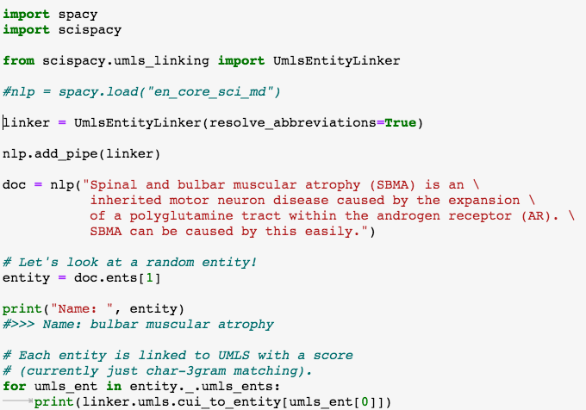
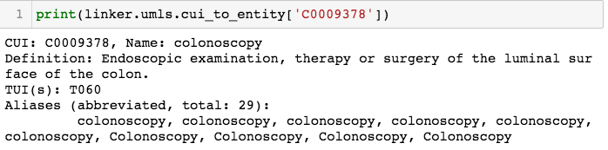
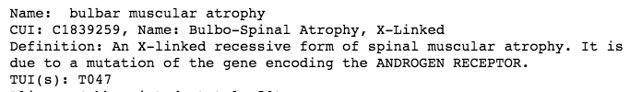
Entity Linking
Entity linking is used to ground named entities to a knowledge base with a unique id.
You can create your own knowledge base and rain a new entity linker
Notes:
Machine learning methods:
Statistical machine learning model – Conditional Random Field
SOTA – Deep learning Transformer Model – “BERT”

Slide 56
NLP APPLICATIONS

Slide 57
NLP APPLICATIONS
Patient deidentification
Medical named entity recognition
Information extraction
Text classification, topic modeling, sentiment analysis
Named entity recognition
Machine translation
Stylistics
Speech recognition
Question answering, intelligent agents, dialog systems
Much more...

Slide 58
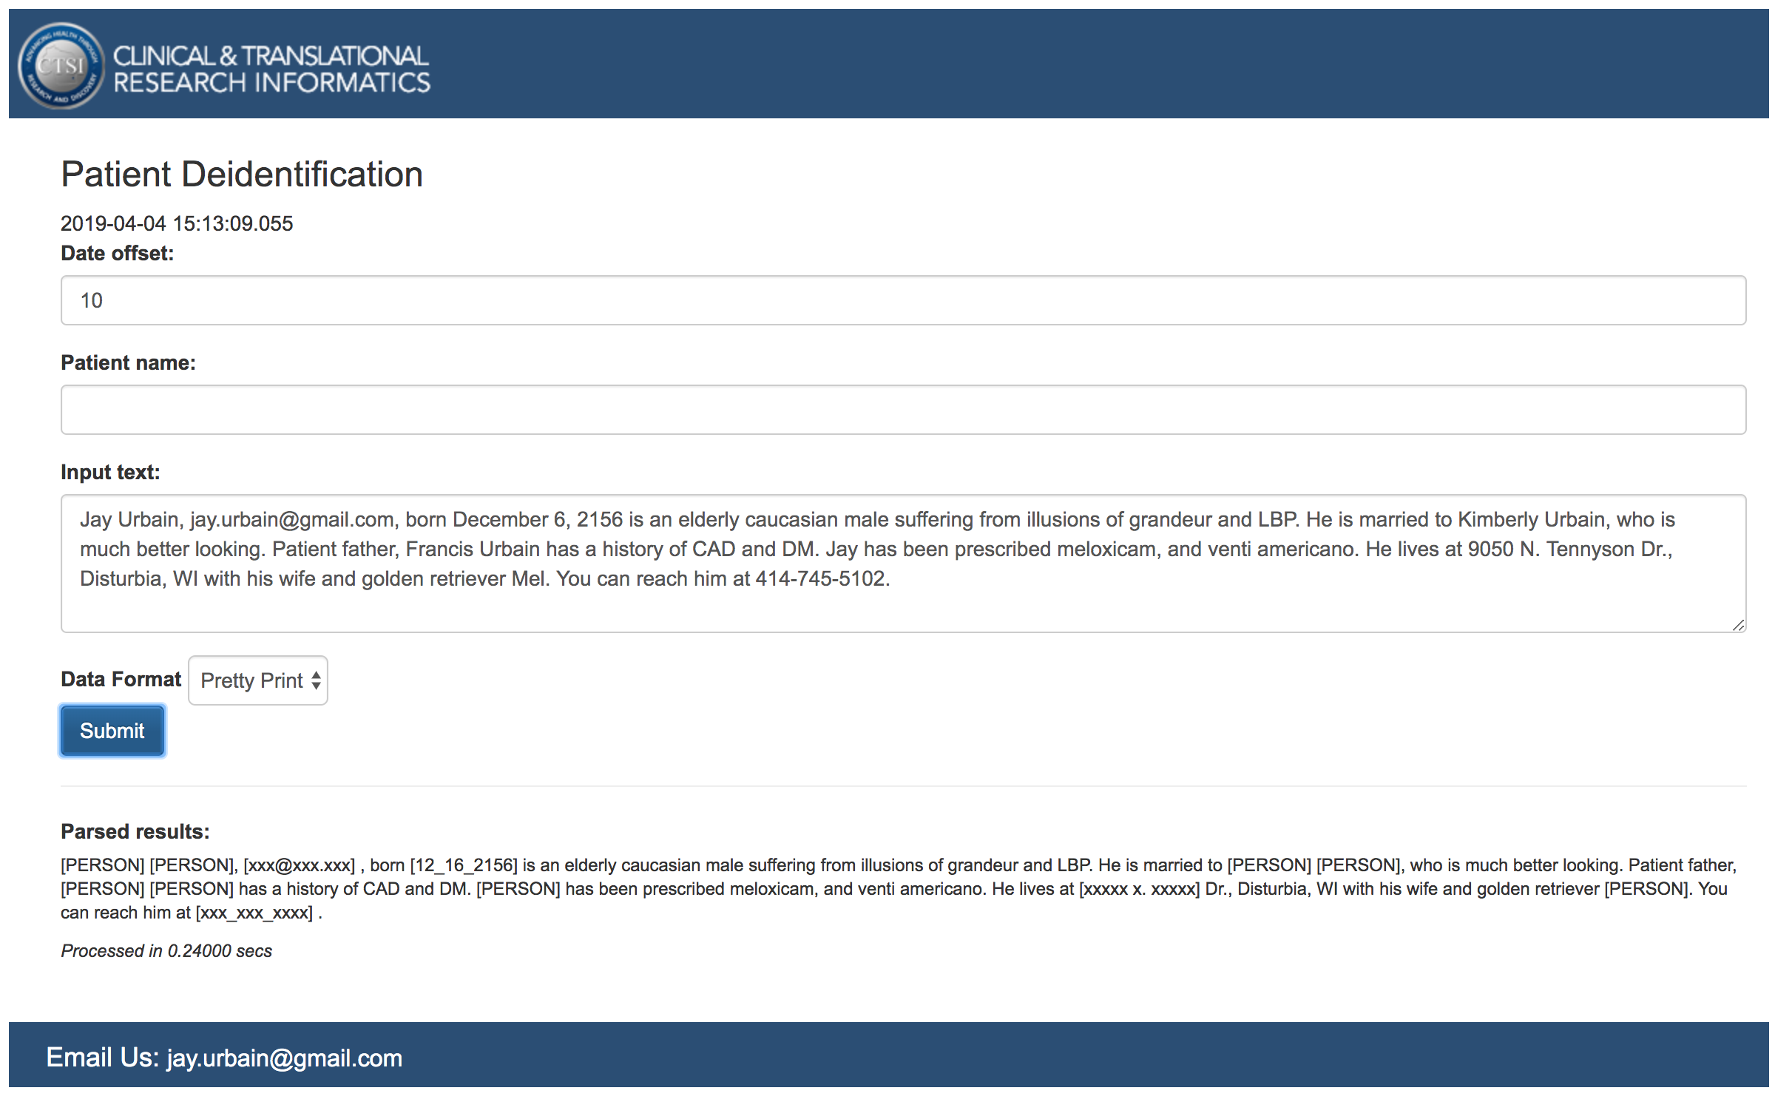
https://cis.ctsi.mcw.edu/deid/
Notes:
curl -H "Content-Type: application/json" -X POST -d '{"dateoffset":"10","name":"Mel","recordlist":["Jay Urbain, jay.urbain@gmail.com, born December 6, 2156 is an elderly caucasian male suffering from illusions of grandeur and LBP.", "He is married to Kimberly Urbain, who is much better looking.", "Patient father, Francis Urbain has a history of CAD and DM.", "Jay has been prescribed meloxicam, and venti americano.", "He lives at 9050 N. Tennyson Dr., Disturbia, WI with his wife and golden retriever Mel.", "You can reach him at 414-745-5102."]}' https://cis.ctsi.mcw.edu/deid/deidservice

Slide 59
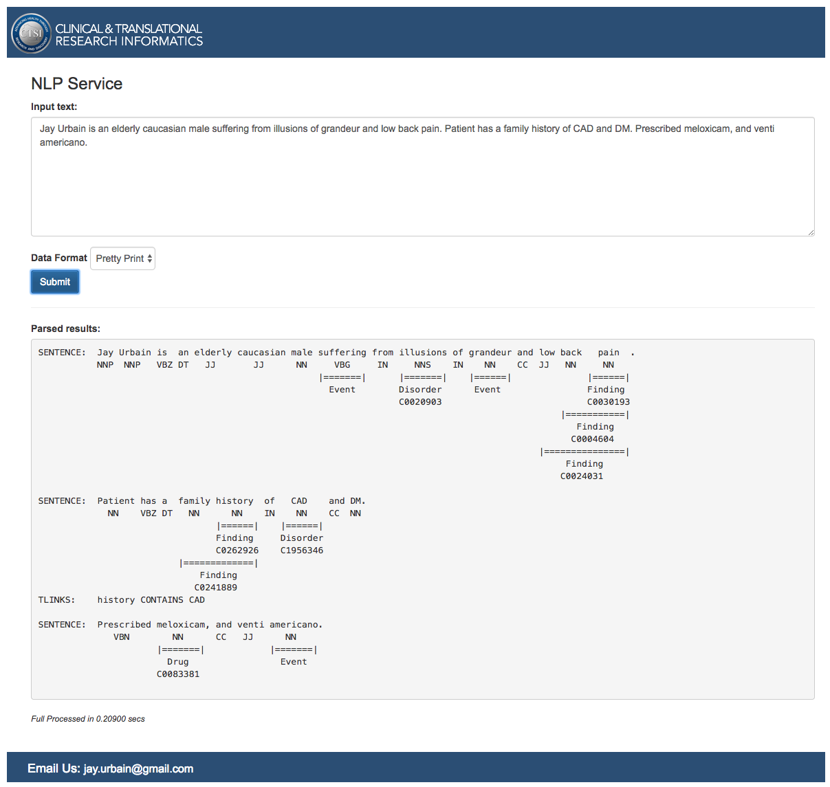
https://cis.ctsi.mcw.edu/nlp/
Clinical Named
Entity Identification
Notes:
curl -H "Content-Type: application/json" -X POST -d '{"recordlist":["Jay is elderly","Treated for illusions of grandeur","Family history of CAD"]}' https://cis.ctsi.mcw.edu/nlp/nlpservice

Slide 60
Information Extraction
Rule based: Regular expressions
Named entity recognition, dependency grammar
Search
Question answering
Dependency parsing for relations
Deep learning

Slide 61
Prologue – Medical Record Machine “Translation” - work with Bradley Crotty, MD
COLONOSCOPY Procedure Note. Date of Procedure: [1_21_2016]. Primary Physician: [PERSON] [PERSON] [PERSON], MD. Attending Physician: [PERSON] [PERSON], MD. Fellow:None. Indications: Colon cancer screening for family history of colon cancer Colon cancer screening for family history of polyps.. Previous COLONOSCOPY: Yes. Date: [8_16_2007]. Medications Administered: Agents given by the anesthesia service during MAC. Procedure Details: The patient was placed in the left lateral position and monitored continuously with ECG tracing, pulse oximetry monitoring and direct observations. Medications were administered incrementally over the course of the procedure to achieve an adequate level of moderate sedation. After anorectal examination was performed, the Olympus CF H180 was inserted into the rectum and advanced under direct vision to the terminal ileum. The procedure was considered not difficult. During withdrawal examination, the final quality of the prep was good.. Bowel Prep Scale Right Colon: Grade 2 (minor amount of residual staining, small fragments of stool, and/or opaque liquid, but mucosa of colon segment is seen well) . Bowel Prep Scale for Transverse Colon: Grade 3 (entire mucosa of colon segment seen well, with no residual staining, small fragments of stool, or opaque liquid) . Bowel Prep Scale for Left Colon: Grade 2 (minor amount of residual staining, small fragments of stool, and/or opaque liquid, but mucosa of colon segment is seen well) Additional rinsing and suctioning (600 ml) were necessary to obtain adequate views. A careful inspection was made as the colonoscope was withdrawn, which did include a retroflexed evaluation of the rectum. Findings and interventions are described below. Appropriate photo documentation was obtained. Overall [PATIENT] L [PATIENT] did tolerate the procedure well, without undue discomfort, hypotension or desaturation. At the completion of the procedure she was transferred from the endoscopy suite to be recovered in the FSC observation area per protocol and was discharged when criteria was met. After adequate recovery from sedation, she was discharged to home, with appropriate plans for follow up in place. Scope in time: 0741 Cecum reached time: 0747. Scope out time: 0759. Findings:. Findings for the Anorectal: No mass. Findings for the Terminal Ileum: Normal ileal mucosa. Findings for the Cecum: Normal mucosa. Findings for the Ascending Colon: Normal mucosa. Findings for the Transverse Colon: 1 polyp 2 mm in size, sessile, removed by cold biopsy and sent for pathology. Findings for the Descending Colon: Normal mucosa. Findings for the Sigmoid Colon: Normal mucosa. Findings for the Rectum: 2 polyps 4 mm in size, sessile, removed by hot biopsy and sent for pathology Hypertrophied anal PAPillae Small anal fissure. Interventions: 1 polyp removed by cold biopsy 2 polyps removed by hot biopsy. Complications: None. Adverse Events: No. Impression: 1. Multiple, 3 colon polyps, removed by cold biopsy and hot biopsy and sent for pathology 2. Family history of colon cancer 3. Family history of polyps 4. Hypertrophied anal PAPillae 5. Anal fissure 6. Otherwise normal COLONOSCOPY to the terminal ileum. Recommendations: ? Avoid aspirin and NSAIDs for 14 days ? Await pathology results ?. Dietary recommendations: High fiber diet. ? Anusol HC or similar ointment for discomfort form anal fissure/PAPillitis ?. Repeat COLONOSCOPY in 5 years ? For the patient's next COLONOSCOPY, a 4 liter, split dose prep should be used. In addition, the patient should start a low residue diet two days before the exam and be on a clear liquid diet the day before the exam. ? Would use large caliber colonoscope ? Follow up with primary care physician. Histopathologic Diagnosis: A. Transverse colon polyp, polypectomy: ? Tubular adenoma. B. Rectal polyps, polypectomy: ? Tubular adenoma (x1). ? Hyperplastic polyp (x1).. Qualify for GI Quality project: Yes #@Screening@# Extent of Examination: #@Complete@# Pathology: #@Adenomatous change@# Appendiceal orifice Ileum Rectal polyp Rectal polyp Anal PAPillitis and small fissure @ 6 o'clock [PERSON] [PERSON] [PERSON], MD, FACP
Translation
Date of procedure:
1_21_2016
Indications for colon cancer screening:
Family history of polyps
Complications:
The procedure was considered not difficult
Findings for the transverse colon:
1 polyp 2mm
Tubular adenoma
Hyperplastic polyp
NSAIDS should be avoided:
14 days
Recommendations:
High fiber diet

Slide 62
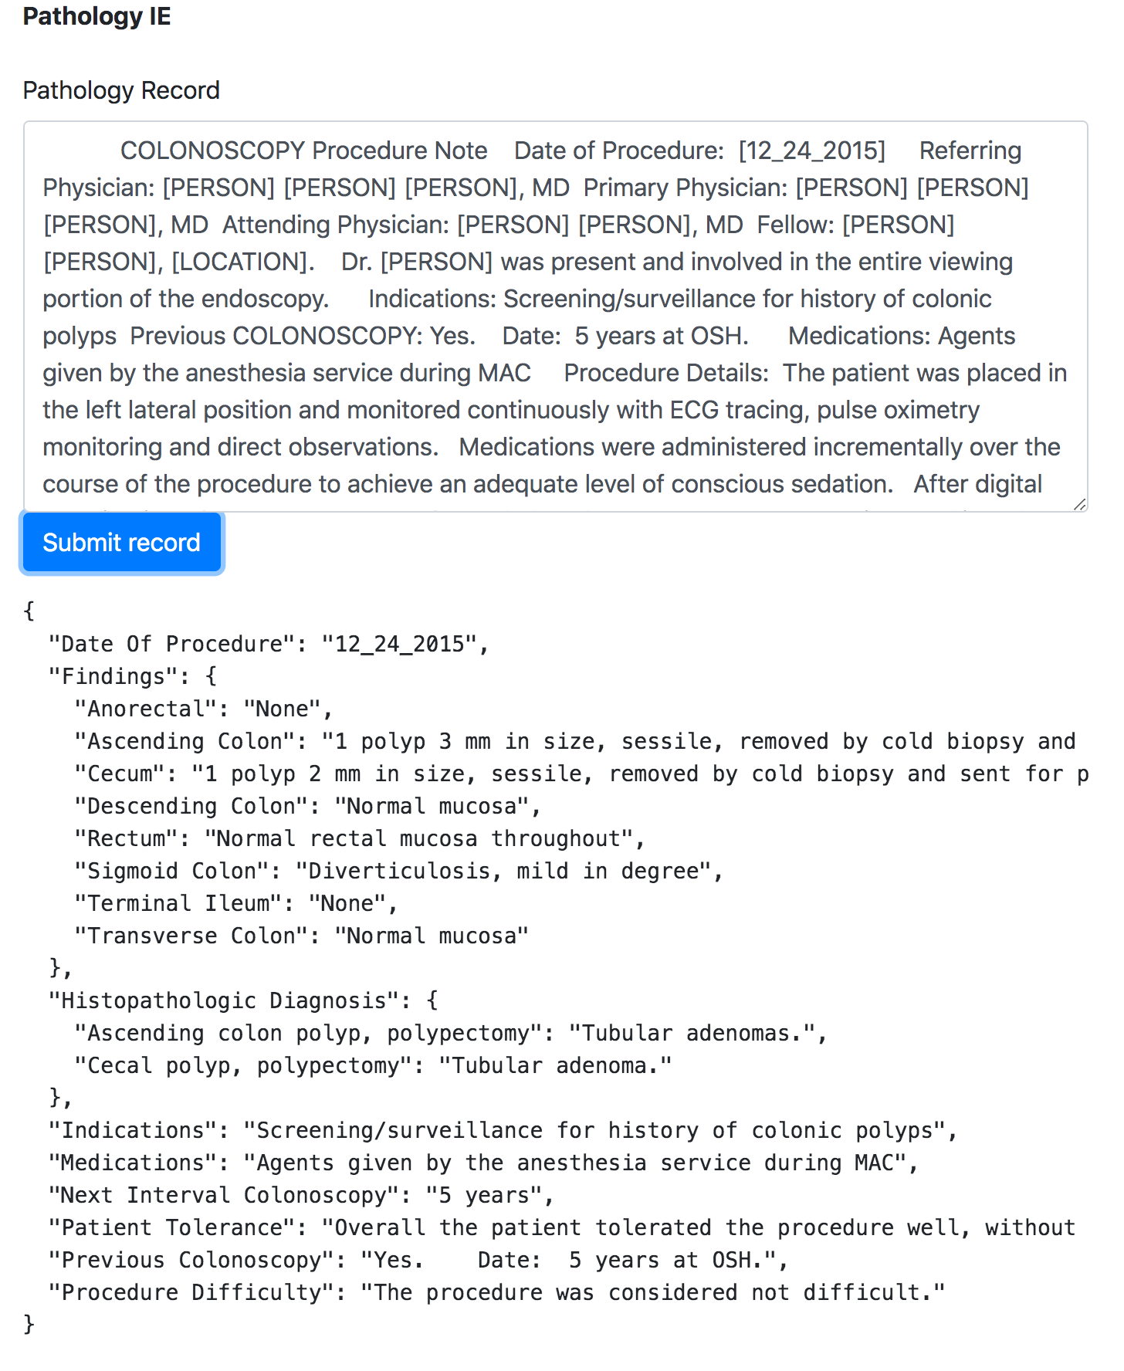
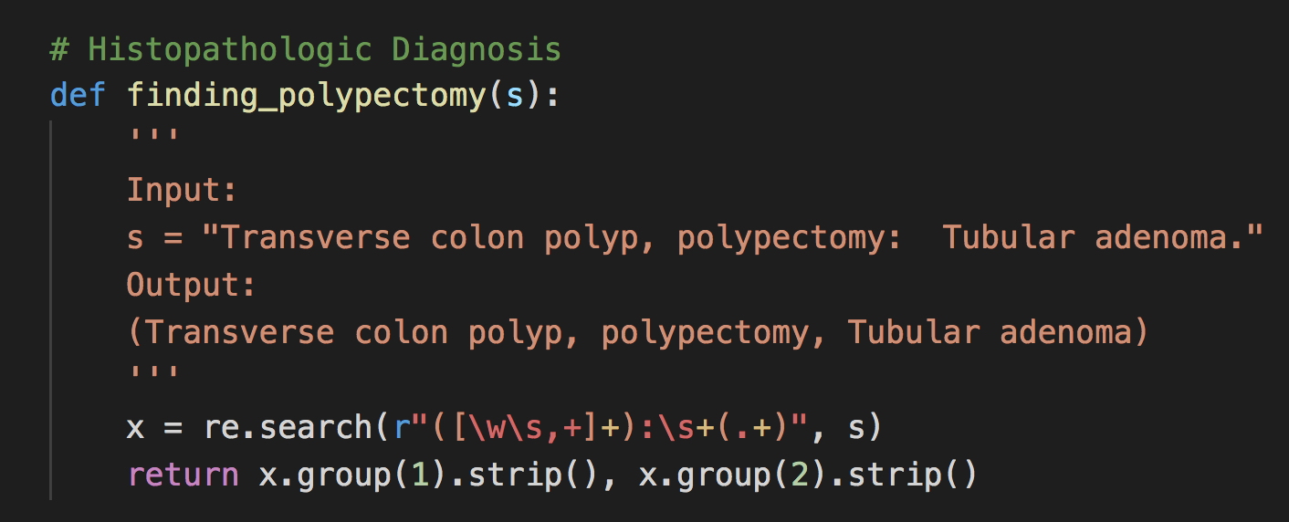
Information Extraction
Rule based - Regular expressions
High precision, low recall
Works well for semi-structured data
Poor generalizability
https://pathology-ie.appspot.com/
Notes:
curl -H 'Content-Type: application/json' -X POST -d '{"record":"COLONOSCOPY Procedure Note Date of Procedure: [12_30_2015] Referring Physician: [PERSON] [PERSON], MD Primary Physician: [PERSON] [PERSON], MD Attending Physician: [PERSON] [PERSON], MD Fellow: None Indications: Evaluate for any evidence of fistulous disease Previous COLONOSCOPY: No Medications Administered: Agents given by the anesthesia service during MAC Procedure Details: The patient was placed in the left lateral position and monitored continuously with ECG tracing, pulse oximetry monitoring and direct observations. Medications were administered incrementally over the course of the procedure to achieve an adequate level of conscious sedation. After anorectal examination was performed, the Olympus CF HQ190L was inserted into the rectum and advanced under direct vision to an impacted view of the terminal terminal ileum. The procedure was considered not difficult except for intubating the TI which was not completed despite multiple attempts in different positions. Overall [PATIENT] L [PATIENT] tolerated the procedure well, without undue discomfort, hypotension or desaturation. The patient was adequately recovered in the endoscopy suite and was discharged to home. During withdrawal examination, the final quality of the prep was [LOCATION] Bowel Prep Scale: Right Colon: Grade 1 (portion of mucosa of the colon segment seen, but other areas of the colon segment are not well seen because of staining, residual stool, and/or opaque liquid) Transverse Colon: Grade 1 (portion of mucosa of the colon segment seen, but other areas of the colon segment are not well seen because of staining, residual stool, and/or opaque liquid) Left Colon: Grade 1 (portion of mucosa of the colon segment seen, but other areas of the colon segment are not well seen because of staining, residual stool, and/or opaque liquid) A careful inspection was made as the colonoscope was withdrawn, including a retroflexed view of the rectum; findings and interventions are described below. Appropriate photo documentation was obtained. The patient tolerated the procedure well, and was recovered in the GI Lab observation area per protocol and was discharged when criteria was met. Scope insertion time: 0925 Cecum reached time: 0930 Scope withdrawal time: 1020 Findings: Anorectal: Normal Terminal Ileum: Only impacted view of terminal ileum obtained; despite multiple attempts unable to intubate the IC valve. What was seen of the terminal ileal mucosa appeared to be normal. The IC valve itself however appears to be narrowed and/or strictured Cecum: Normal mucosa except for 1 erosion on cecal fold above [LOCATION] valve without frank ulceration; biopsied separately Ascending Colon: Normal mucosa Transverse Colon: Normal mucosa Descending Colon: Normal mucosa Sigmoid Colon: Normal mucosa Rectum: Normal rectal mucosa throughout; linear erosions with shallow ulcerations on 3 folds in the rectum. Biopsies obtained. Findings are not typical of inflammatory bowel disease. Interventions: Biopsies obtained of the IC valve/distal TI, fold with erosion in cecum, random colon and rectal erosions/ulcers. Complications: None Impression: No fistula noted on this examination Very poor preparation Rectal and Cecal fold erosions shallow ulcerations as above Difficult to intubate IV valve; unclear whether this represents stricture, angulation or operator dependent Otherwise normal COLONOSCOPY to the terminal ileum Recommendations: Await pathology results Discussed with Dr. [PERSON] we will await biopsies and then decide on next steps after those are back and repeat CT scan is completed Should also better delineate NSAID history Histopathologic Diagnosis:pending Qualify for GI Quality project: No Kia Saeian, MD Addendum Pathology: A. TI, biopsy: ? Small bowel mucosa with no diagnostic abnormality. B. Cecal fold, biopsy: ? Colonic mucosa with focal mucosal erosion and regenerative changes; see note. Note: There is no definite morphologic evidence sugestive of inflammatory bowel ? disease. C. Random colon, biopsy: ? Colonic mucosa with no diagnostic abnormality. D. Rectum, biopsy: ? Colonic mucosa with focal nonspecific inflammation and regenerative changes."}' https://pathology-ie.appspot.com/api

Slide 63
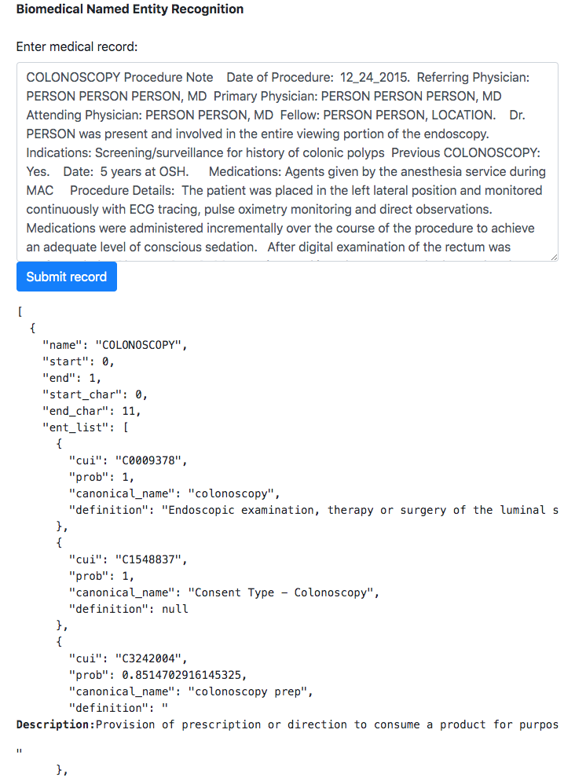
Information Extraction
Named Entity Model
Can use with dependency parse
Train machine learning model (sequence model)
Often can leverage pretrained model
Better recall and generalizability
Can suffer from lack of training data
http://35.194.6.2:8000/

Slide 64
Information Extraction
Custom Named Entity Model
Leverage pretrained model
T1 C0040861_Triage 14 20 triage
T2 C0030193_Pain 47 51 pain
T3 C0184661_Interventional_procedure 133 143 procedures
T4 C0449210_OTH_tumor_staging_notation 162 167 other
T5 C1304888_Pain_control 168 180 pain control
T6 C0030193_Pain 168 172 pain
T7 C0013227_Pharmaceutical_Preparations 228 238 medication
T8 C0020746_Ice 254 257 ice
T9 C0556030_Repositioning_procedure 262 275 repositioning
T10 C0537670_Oprelvekin 293 301 Informed
T11 C1299581_Able_finding 429 433 able
T12 C0310367_Today 449 454 today
T13 C0004448_Awareness 469 474 aware
T14 C0310367_Today 528 533 today
Patient LM on triage line reporting unbearable pain, requesting call back. This writer placed callback to patient, reviewed recent procedures, current meds and other pain control options with patient. Patient reports taking medication as prescribed, ice and repositioning not effective. Informed patient I would speak with provider to discuss options and call him back. Spoke with APNP MA, update given. MA able to see patient today. Scheduling aware and contacted patient. Patient scheduled for 11:40 today.

Slide 65
Information Extraction
Named Entity Model
Update annotations
https://brat.nlplab.org/standoff.html

Slide 66
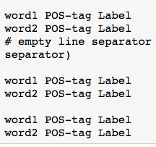
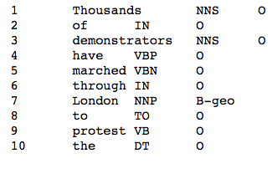
Information Extraction
Named Entity Model
Train new model

Slide 67
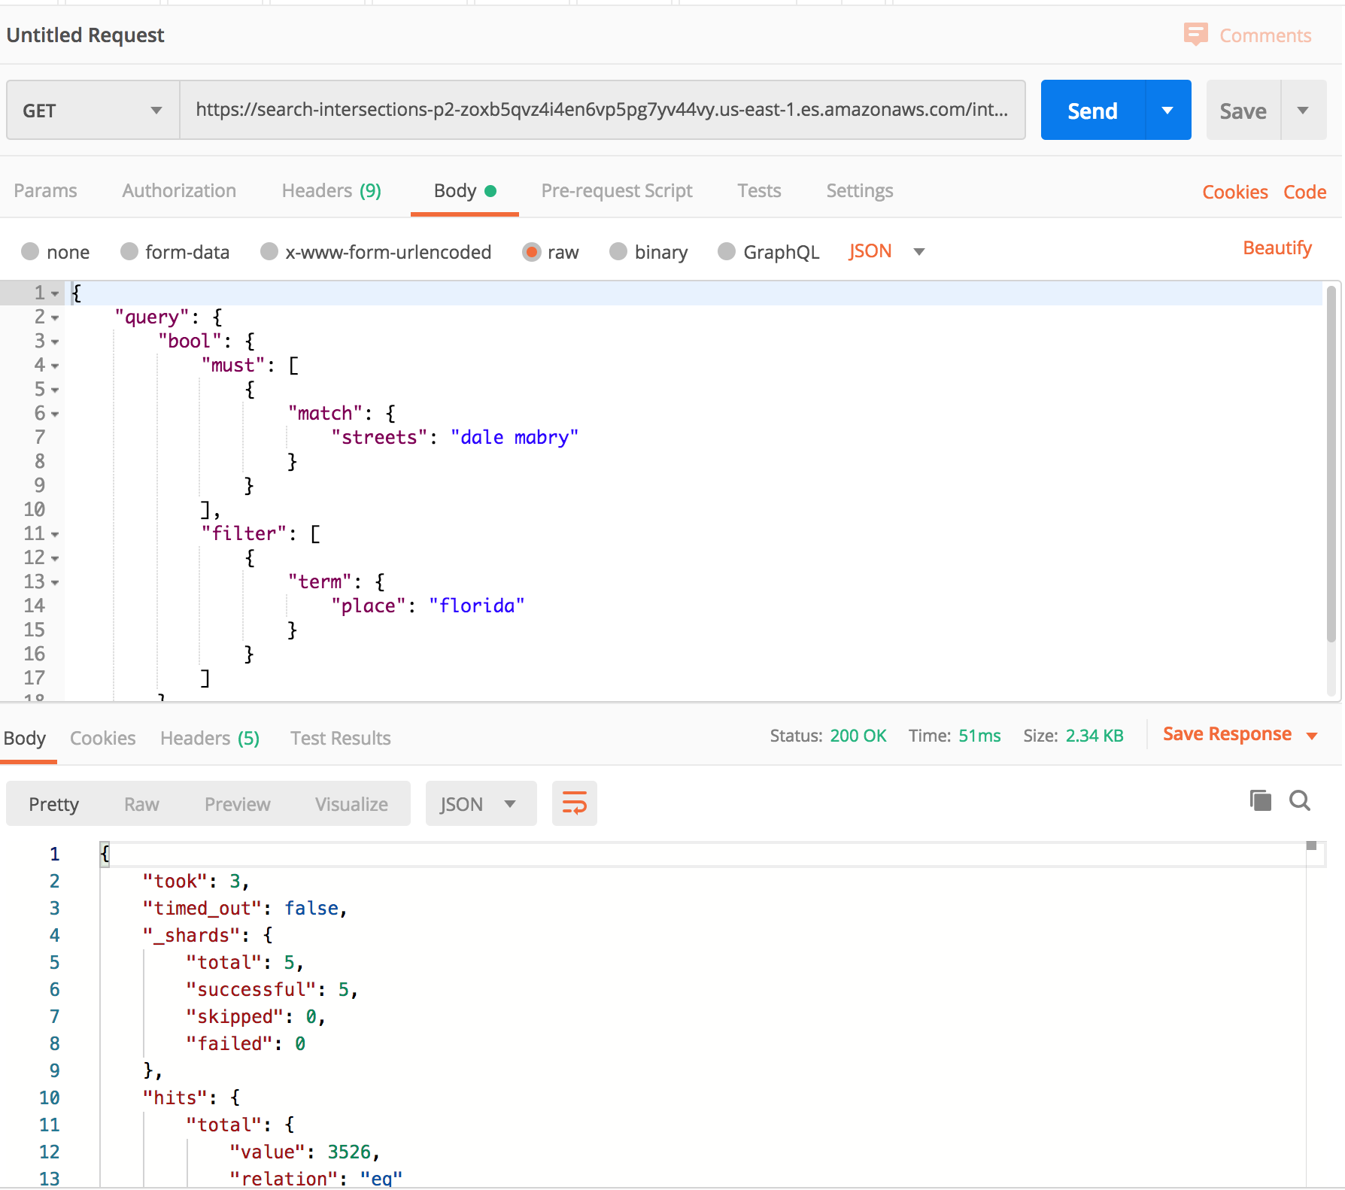
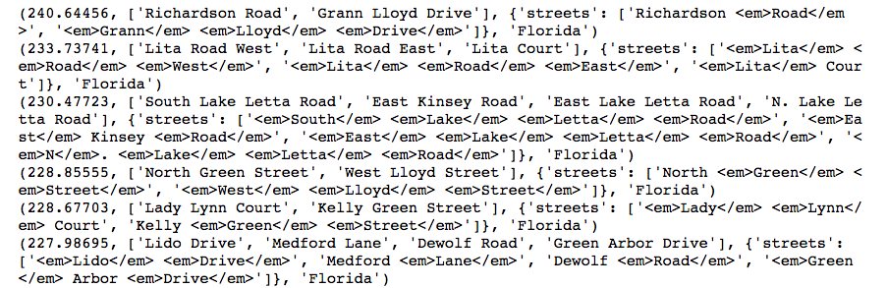
Information Extraction
Search (inverse)
Index as entities of interest
Query as document

Slide 68
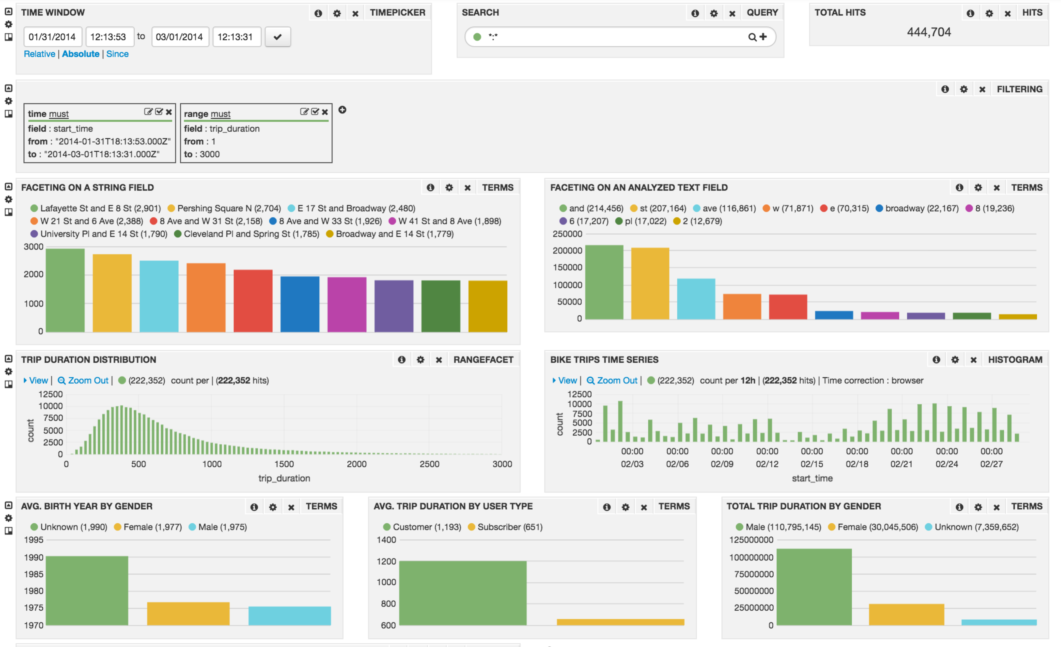
Search driven discovery: aggregating statistics from named entities

Slide 69
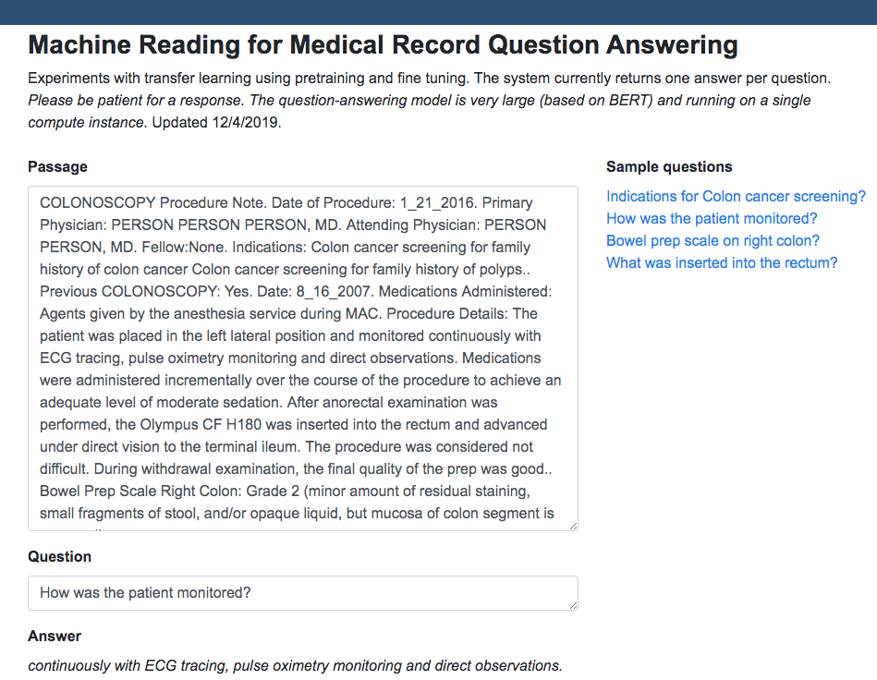
Question Answering
http://34.72.246.239:8080/

Slide 70
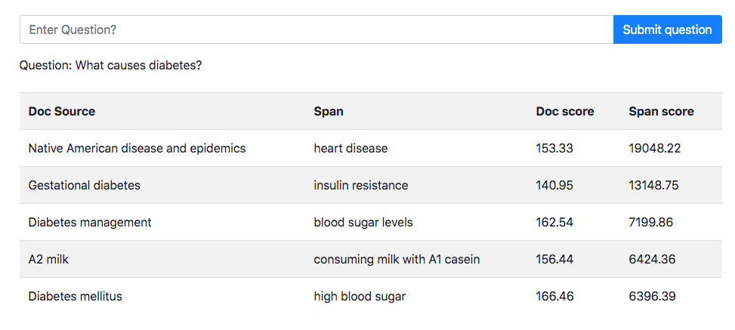
Open Domain Question Answering

Slide 71
Topic Models: Passage-Concept TREC Collection
Concept 1: Blood protein | Concept 2: Lupus Erythematosus | Concept 8: Lysosome | Topic 57: Signaling pathway
antibodi (0.4895) cell (0.2565) serum (0.2158) anti (0.2042) plasma (0.1544) protein (0.1498) membran (0.0869) incub (0.0718) human (0.0713) monoclon (0.0677) express (0.0623) bind (0.0596) concentr (0.0541) beta (0.0513) IG (0.0507) alpha (0.0477) mous (0.0477) rabbit (0.0459) CD (0.0434) glycoprotein (0.0423) | lupu (0.6477) SLE (0.4645) system (0.3527) patient (0.3482) erythematosu (0.3394) diseas (0.1749) antibodi (0.1172) cell(0.1109) anti (0.0779) nephriti (0.0744) mice (0.0618) autoantibodi(0.0599) clinic (0.0579) autoimmun (0.0557) DNA (0.0545) human (0.0479) syndrom (0.0429) factor (0.0428) ISI ( 0.0424) IG ( 0.0382) | lysosom (0.9999) cell (0.2326) protein (0.1848) membran (0.1514) endosom (0.1297) enzym (0.1019) degrad (0.0912) transport (0.0778) acid (0.0704) compart (0.0644) storag (0.0597) target (0.0582) pathwai (0.0540) accumul (0.0536) diseas (0.0528) human (0.0522) express (0.0474) cathepsin (0.0456) organel (0.0414) golgi (0.0402) | signal (0.7022) pathwai (0.4053) cell (0.2482) protein (0.1805) regul (0.1107) express (0.0970) kinase (0.0896) receptor (0.0861) mediat (0.0842) gene (0.0788) factor (0.0737) transduct (0.0650) beta (0.0597) respons (0.0557) bind (0.0515) inhibit (0.0502) transcript(0.0478) interact (0.0390) NF (0.0381) SRP (0.0380)
Notes:
Latent Dirichlet Bayesian topic model. Written from scratch

Slide 72
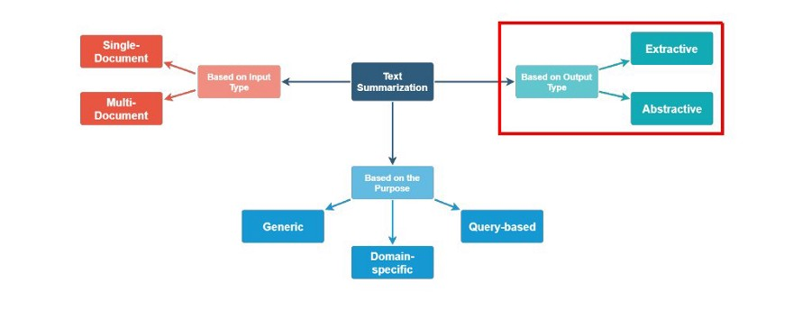
Text Summarization
Extractive text summarization
Extract representative sentences from document(s). Classification task.
Abstractive text summarization
Generate summary. May include words not in the original document. compressed paraphrasing of the main contents of the document
Fine-tune BERT for Extractive Summarization, “BertSum”, Liu, 2019.
Text Summarization with Pretrained Encoders, Liu, Lapata, 2019.
Notes:
Challenge: understanding of document to produce representative summaries.
Fine-tune BERT for Extractive SummarizationYang LiuInstitute for Language, Cognition and ComputationSchool of Informatics, University of Edinburgh10 Crichton Street, Edinburgh EH8 9AByang.liu2@ed.ac.ukAbstractBERT (Devlin et al., 2018), a pre-trainedTransformer (Vaswani et al., 2017) model,has achieved ground-breaking performance onmultiple NLP tasks. In this paper, we describeBERTSUM, a simple variant of BERT, for ex-tractive summarization. Our system is the stateof the art on the CNN/Dailymail dataset, out-performing the previous best-performed sys-tem by 1.65 on ROUGE-L. The codes to repro-duce our results are available at https://github.com/nlpyang/BertSum
Text Summarization with Pretrained Encoders
Yang Liu, Mirella Lapata
Bidirectional Encoder Representations from Transformers (BERT) represents the latest incarnation of pretrained language models which have recently advanced a wide range of natural language processing tasks. In this paper, we showcase how BERT can be usefully applied in text summarization and propose a general framework for both extractive and abstractive models. We introduce a novel document-level encoder based on BERT which is able to express the semantics of a document and obtain representations for its sentences. Our extractive model is built on top of this encoder by stacking several inter-sentence Transformer layers. For abstractive summarization, we propose a new fine-tuning schedule which adopts different optimizers for the encoder and the decoder as a means of alleviating the mismatch between the two (the former is pretrained while the latter is not). We also demonstrate that a two-staged fine-tuning approach can further boost the quality of the generated summaries. Experiments on three datasets show that our model achieves state-of-the-art results across the board in both extractive and abstractive settings. Our code is available at this https URL
https://arxiv.org/pdf/1908.08345.pdf

Slide 73
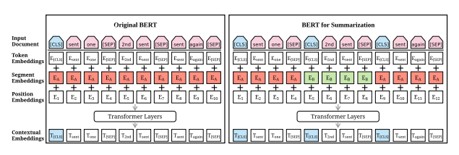
Text Summarization - BertSUM
Selects the most important sentences from a document(s).
Insert [CLS] tokens at the start of each sentence.
Each [CLS] symbol collects features for the sentence preceding it.
Use interval segment embedding (E_{A}, E_{B}) to distinguish multiple sentences.
Fine-tune BERT for Extractive Summarization, “BertSum”, Liu, 2019.
Notes:
Challenge: understanding of document to produce representative summaries.
Fine-tune BERT for Extractive Summarization, Yang Liu, Institute for Language, Cognition and Computation School of Informatics, University of Edinburgh10 Crichton Street, Edinburgh EH8 9AByang.liu2@ed.ac.ukAbstractBERT (Devlin et al., 2018), a pre-trained Transformer (Vaswani et al., 2017) model has achieved ground-breaking performance on multiple NLP tasks. In this paper, we describe BERTSUM, a simple variant of BERT, for ex-tractive summarization. Our system is the state of the art on the CNN/Daily mail dataset, out-performing the previous best-performed system by 1.65 on ROUGE-L. The codes to repro-duce our results are available at https://github.com/nlpyang/BertSum
Text Summarization with Pretrained Encoders
Yang Liu, Mirella Lapata
Bidirectional Encoder Representations from Transformers (BERT) represents the latest incarnation of pretrained language models which have recently advanced a wide range of natural language processing tasks. In this paper, we showcase how BERT can be usefully applied in text summarization and propose a general framework for both extractive and abstractive models. We introduce a novel document-level encoder based on BERT which is able to express the semantics of a document and obtain representations for its sentences. Our extractive model is built on top of this encoder by stacking several inter-sentence Transformer layers. For abstractive summarization, we propose a new fine-tuning schedule which adopts different optimizers for the encoder and the decoder as a means of alleviating the mismatch between the two (the former is pretrained while the latter is not). We also demonstrate that a two-staged fine-tuning approach can further boost the quality of the generated summaries. Experiments on three datasets show that our model achieves state-of-the-art results across the board in both extractive and abstractive settings. Our code is available at this https URL
https://arxiv.org/pdf/1908.08345.pdf

Slide 74

Text Summarization - BertSUM
Outputs a list of scores showing how well each sentence represents the documents. [sent1, sent2, sent3, sent4, sent5] has scores [score1, score2, score3, score4, score5].
The output is then feed into Summarization Layers for summarization.
Fine-tune BERT for Extractive Summarization, “BertSum”, Liu, 2019.
Notes:
Challenge: understanding of document to produce representative summaries.
Fine-tune BERT for Extractive SummarizationYang LiuInstitute for Language, Cognition and ComputationSchool of Informatics, University of Edinburgh10 Crichton Street, Edinburgh EH8 9AByang.liu2@ed.ac.ukAbstractBERT (Devlin et al., 2018), a pre-trainedTransformer (Vaswani et al., 2017) model,has achieved ground-breaking performance onmultiple NLP tasks. In this paper, we describeBERTSUM, a simple variant of BERT, for ex-tractive summarization. Our system is the stateof the art on the CNN/Dailymail dataset, out-performing the previous best-performed sys-tem by 1.65 on ROUGE-L. The codes to repro-duce our results are available at https://github.com/nlpyang/BertSum
Text Summarization with Pretrained Encoders
Yang Liu, Mirella Lapata
Bidirectional Encoder Representations from Transformers (BERT) represents the latest incarnation of pretrained language models which have recently advanced a wide range of natural language processing tasks. In this paper, we showcase how BERT can be usefully applied in text summarization and propose a general framework for both extractive and abstractive models. We introduce a novel document-level encoder based on BERT which is able to express the semantics of a document and obtain representations for its sentences. Our extractive model is built on top of this encoder by stacking several inter-sentence Transformer layers. For abstractive summarization, we propose a new fine-tuning schedule which adopts different optimizers for the encoder and the decoder as a means of alleviating the mismatch between the two (the former is pretrained while the latter is not). We also demonstrate that a two-staged fine-tuning approach can further boost the quality of the generated summaries. Experiments on three datasets show that our model achieves state-of-the-art results across the board in both extractive and abstractive settings. Our code is available at this https URL
https://arxiv.org/pdf/1908.08345.pdf

Slide 75
Text Summarization
text_body = '''
The Chrysler Building, the famous art deco New York skyscraper, will be sold for a small fraction of its previous sales price.
The deal, first reported by The Real Deal, was for $150 million, according to a source familiar with the deal.
Mubadala, an Abu Dhabi investment fund, purchased 90% of the building for $800 million in 2008.
Real estate firm Tishman Speyer had owned the other 10%.
The buyer is RFR Holding, a New York real estate company.
Officials with Tishman and RFR did not immediately respond to a request for comments.
It's unclear when the deal will close.
The building sold fairly quickly after being publicly placed on the market only two months ago.
The sale was handled by CBRE Group.
The incentive to sell the building at such a huge loss was due to the soaring rent the owners pay to Cooper Union, a New York college, for the land under the building.
The rent is rising from $7.75 million last year to $32.5 million this year to $41 million in 2028.
Meantime, rents in the building itself are not rising nearly that fast.
While the building is an iconic landmark in the New York skyline, it is competing against newer office towers with large floor-to-ceiling windows and all the modern amenities.
Still the building is among the best known in the city, even to people who have never been to New York.
It is famous for its triangle-shaped, vaulted windows worked into the stylized crown, along with its distinctive eagle gargoyles near the top.
It has been featured prominently in many films, including Men in Black 3, Spider-Man, Armageddon, Two Weeks Notice and Independence Day.
The previous sale took place just before the 2008 financial meltdown led to a plunge in real estate prices.
Still there have been a number of high profile skyscrapers purchased for top dollar in recent years, including the Waldorf Astoria hotel, which Chinese firm Anbang Insurance purchased in 2016 for nearly $2 billion, and the Willis Tower in Chicago, which was formerly known as Sears Tower, once the world's tallest.
Blackstone Group (BX) bought it for $1.3 billion 2015.
The Chrysler Building was the headquarters of the American automaker until 1953, but it was named for and owned by Chrysler chief Walter Chrysler, not the company itself.
Walter Chrysler had set out to build the tallest building in the world, a competition at that time with another Manhattan skyscraper under construction at 40 Wall Street at the south end of Manhattan. He kept secret the plans for the spire that would grace the top of the building, building it inside the structure and out of view of the public until 40 Wall Street was complete.
Once the competitor could rise no higher, the spire of the Chrysler building was raised into view, giving it the title.
'''

Slide 76

Text Summarization
Response Time: 0.29914021492004395 Summary: The Chrysler Building, the famous art deco New York skyscraper, will be sold for a small fraction of its previous sales price. Mubadala, an Abu Dhabi investment fund, purchased 90% of the building for $800 million in 2008. The buyer is RFR Holding, a New York real estate company. It has been featured prominently in many films, including Men in Black 3, Spider-Man, Armageddon, Two Weeks Notice and Independence Day.

Slide 77
Text Summarization
text_body2 = '''
COLONOSCOPY Procedure Note Date of Procedure: [12_24_2015] Referring Physician: [PERSON] [PERSON] [PERSON], MD Primary Physician: [PERSON] [PERSON] [PERSON],
MD Attending Physician: [PERSON] [PERSON], MD Fellow: [PERSON] [PERSON], [LOCATION]. Dr. [PERSON] was present and involved in the entire viewing portion of the endoscopy.
Indications: Screening/surveillance for history of colonic polyps Previous COLONOSCOPY: Yes. Date: 5 years at OSH.
Medications: Agents given by the anesthesia service during MAC Procedure Details: The patient was placed in the left lateral position and monitored continuously
with ECG tracing, pulse oximetry monitoring and direct observations. Medications were administered incrementally over the course of the procedure to achieve an
adequate level of conscious sedation. After digital examination of the rectum was performed, the Olympus CF HQ190L was inserted into the rectum and advanced
under direct vision to the cecum, which was identified by the ileocecal valve and appendiceal orifice. The procedure was considered not difficult. Overall
the patient tolerated the procedure well, without undue discomfort, hypotension or desaturation. The patient was adequately recovered in the endoscopy suite
and was discharged to home. During withdrawal examination, the final quality of the prep was [LOCATION] Bowel Prep Scale: Right Colon: Grade 2
(minor amount of residual staining, small fragments of stool, and/or opaque liquid, but mucosa of colon segment is seen well) Transverse Colon: Grade 2
(minor amount of residual staining, small fragments of stool, and/or opaque liquid, but mucosa of colon segment is seen well) Left Colon: Grade 2
(minor amount of residual staining, small fragments of stool, and/or opaque liquid, but mucosa of colon segment is seen well) Additional rinsing and
suctioning were necessary to obtain adequate views. A careful inspection was made as the colonoscope was withdrawn. This did include a retroflexed
evaluation of the rectum. Findings and interventions are described below. Appropriate photo documentation was obtained. Overall [PATIENT] F [PATIENT]
did tolerate the procedure well, without undue discomfort, hypotension, or desaturation. At the completion of the procedure he was transferred from the
endoscopy suite to be recovered in the GI Lab observation area per protocol and was discharged when criteria was met. After adequate recovery from sedation,
he was discharged to home, with appropriate plans for follow up in place. Scope in time: 1131 Cecum reached time: 1143 Scope out time: 1157
Findings: Anorectal: Normal Cecum: 1 polyp 2 mm in size, sessile, removed by cold biopsy and sent for pathology Ascending Colon: 1 polyp 3 mm in size,
sessile, removed by cold biopsy and sent for pathology Transverse Colon: Normal mucosa Descending Colon: Normal mucosa Sigmoid Colon:
Diverticulosis, mild in degree Rectum: Normal rectal mucosa throughout Interventions: 2 polyps removed by cold biopsy Complications: None
Adverse Events: No Impression: 1. Multiple, 2 colon polyps, removed by cold biopsy and sent for pathology 2. Mild diverticulosis of left side 3.
Otherwise, normal COLONOSCOPY to cecum Recommendations: Repeat COLONOSCOPY in 5 years Next Interval COLONOSCOPY: 5 years Histopathologic Diagnosis: A. Cecal polyp, polypectomy: ?
Tubular adenoma. B. Ascending colon polyp, polypectomy: ? Tubular adenomas. Qualify for GI Quality project: Yes #@Surveillance@# Extent of Examination: #@Complete@#
Pathology: #@Adenomatous change@# Gokulakrishnan Balasubramanian, MD GI Faculty Note I was present for the entire viewing portion of the endoscopy and performed the
entire procedure with Dr. [PERSON]. [PERSON] [PERSON] [PERSON], MD Assistant Professor, Division of Gastroenterology Medical College of Wisconsin
'''

Slide 78

Text Summarization
Response Time: 0.26926517486572266 Summary: COLONOSCOPY Procedure Note Date of Procedure: [12_24_2015] Referring Physician: [PERSON] [PERSON] [PERSON], MD Primary Physician: [PERSON] [PERSON] [PERSON], MD Attending Physician: [PERSON] [PERSON], MD Fellow: [PERSON] [PERSON], [LOCATION]. Dr. [PERSON] was present and involved in the entire viewing portion of the endoscopy. Medications: Agents given by the anesthesia service during MAC Procedure Details: The patient was placed in the left lateral position and monitored continuously with ECG tracing, pulse oximetry monitoring and direct observations. A careful inspection was made as the colonoscope was withdrawn. Otherwise, normal COLONOSCOPY to cecum Recommendations: Repeat COLONOSCOPY in 5 years Next Interval COLONOSCOPY: 5 years Histopathologic Diagnosis: A. Cecal polyp, polypectomy: ? Qualify for GI Quality project: Yes #@Surveillance@# Extent of Examination: #@Complete@# Pathology: #@Adenomatous change@# Gokulakrishnan Balasubramanian, MD GI Faculty Note I was present for the entire viewing portion of the endoscopy and performed the entire procedure with Dr. [PERSON]. [PERSON] [PERSON] [PERSON], MD Assistant Professor, Division of Gastroenterology Medical College of Wisconsin

Slide 79

Text Summarization – co-reference resolution
['My sister has a dog.', 'My sister loves a dog.']

Slide 80

Healthcare Knowledge Graph Linking Disease, Symptom, & Health Risk Factors
Rotmensch, M., Halpern, Y., Tlimat, A. et al. Learning a Health Knowledge Graph from Electronic Medical Records. Sci Rep 7, 5994 (2017). https://doi.org/10.1038/s41598-017-05778-z
Notes:
Very interesting deep graph neural network libraries being developed.

Slide 81
REPRESENTING TEXT

Slide 82
ONE-HOT ENCODING
Words are categorical, they have no ordinal relationship. So, they can’t just be numerically encoded.
For each word:
Numerically encode each word: {red:0, green:1, blue:2}
Generate vector of zeros the length of all possible words/categories
Set the index value for the word in the vector
red, green, blue
1, 0, 0
0, 1, 0
0, 0, 1

Slide 83

WORD EMBEDDINGS
One-hot results in sparse vector representation (mostly zeros, hi dimensions).
Word embeddings provide dense vector representations.
Idea is to “embed” words into a lower-dimensionality space.
The dimensions of this space are typically defined by word context, i.e., semantically similar words are embedded near each other.
Popular algorithms:
Point-wise mutual information (PMI)
Word2Vec: Skip-gram or CBOW
GLoVE

Slide 84


Slide 85

Embeddings: Projects into a word embedding space
https://www.tensorflow.org/tutorials/representation/word2vec

Slide 86


Slide 87
NETWORK ARCHITECTURE – RNNS / LSTMS

Slide 88

RECURRENT LAYERS
RNNs share the weights between the time steps
Condition the neural network on all previous words
(and all document in the end)
RAM requirement only scales with number of timesteps

Slide 89
STATE OF THE ART

Slide 90



NLP: With deep Learning, reality is getting closer to vision
Alexa, re-order Thai Peanut Sauce
Ok Google, what’s my commute?
Siri, play Stompy the Bear
Notes:
Now if you’re in AI, you’ve probably been excited about AI since you were about … eight years old. I know I have.
For years, we’ve all been dreaming about having computers that can talk to us.
The ability to use language is an essential ingredient of the AI vision,
and the quest to endow computers with this ability has been the ultimate driver of NLP research for more than 50 years.
This dream is ultimately the reason why I’m standing here today. [>]

Slide 91

Encoder-Decoder Architecture Sequence-to-Sequence Model - Neural Machine Translation
Encoder RNN encodes input sequence into a fixed size vector, and then is passed repeatedly to decoder RNN.

Slide 92


Neural Machine Translation (encoding)
source language (English)
source language (English)
target language (French)
target language (French)

Slide 93

Attention
Attention mechanism allows the network to refer back to the input sequence, instead of forcing it to encode all information into one fixed length vector.

Slide 94

Self-Attention
"The animal didn't cross the street because it was too tired"

Slide 95


Transformer

Slide 96


Slide 97


Slide 98
Links
Here is a list of Github repositories of recent courses I’ve developed:
https://github.com/jayurbain/DataScienceIntro
https://github.com/jayurbain/machine-learning
https://github.com/jayurbain/artificial-intelligence
Data Driven Wisconsin Workshop:
https://github.com/jayurbain/DeepNLPIntro2019
https://www.datadrivenwi.org/ .

Slide 99

LEVELS OF NLP Add structure to unstructured text
Phonology - how do we pronounce words
Morphology – how words are formed, and how they relate to other words
Syntax - how sentences are structured
Semantics - what does all of this means
Discourse – conversation, dialog, writing
Notes:
Add structure at multiple levels

Slide 100
What’s special about human language?
Human language is a symbolic/categorical signaling system.
However, a brain encoding appears to be a continuous pattern of activation, and the symbols are transmitted via continuous signals of sound/vision.
The large vocabulary, symbolic encoding of words creates a problem for machine learning – sparsity!
Research opportunity: explore a continuous encoding pattern of thought.

Slide 101

Traditional NLP use “shallow” statistical machine learning models: HMM, MEMM, CRF
http://homepages.inf.ed.ac.uk/csutton/publications/crftut-fnt.pdf

Slide 102


Traditional Models: HMM, MEMM, CRF
http://homepages.inf.ed.ac.uk/csutton/publications/crftut-fnt.pdf
Linear chain CRF for sequence class, Named entity CRF features
Custom solutions for each domain, and for each application.
Difficulty capturing long-range dependencies, context, and semantics

Slide 103
Deep Learning

Slide 104

What’s Deep Learning (DL)?
Deep learning is a subfield of machine learning
Most machine learning methods work well because of human-designed representations and input features
For example: features for finding named entities like locations or organization names (Finkel et al., 2010):
Machine learning becomes optimizing weights to best make a final prediction

Slide 105

Machine Learning/Deep Learning
Parameterized by its weights
A loss function measures the quality of the network’s output
The loss score is used as a feedback signal to adjust the weights

Slide 106

HOW IT WORKS
Notes:
Once the model has been trained, much of the generalized flexibility that was necessary during the training process is no longer needed, so it’s possible to optimize the model for significantly faster runtime performance.
[Story: How Cooper learned to classify cars, “tucks”, busses, motorcycles, etc.]
Common optimizations include fusing layers to reduce memory and communication overhead, pruning nodes that do not contribute significantly to the results, and other techniques supported in the NVIDIA TensorRT runtime.
The fully trained and optimized model is then ready to be integrated into an application that will feed it new data, in this case images of dogs and cats that it hasn’t seen before, and it will be able to quickly and accurately infer the correct answer based on its training. And your application can be deployed on a GPU-accelerated platform in your datacenter, in the cloud, on a local workstation, in a robot, a smart camera, or even a self-driving car.

Slide 107

What’s Deep Learning (DL)?
In contrast to standard machine learning,
Representation learning attempts to automatically learn good features or representations
Deep learning algorithms attempt to learn (multiple levels of) representations (here: h1,h2,h3) and an output (h4)
From “raw” inputs x (e.g. sound, pixels, characters, or words)

Slide 108


Slide 109



Difference in Workflow
Examples [ Regression and SVMs ]
Classic Machine Learning [ 1990 : now ]
Hand Designed Features
Model / Mapping
Input
Output
Deep/End-to-End Learning [ 2012 : now ]
Example [ Conv Net ]
Simple Features
Complex Features
Model/ Mapping
Input
Output
Machine learning workflow shifts from engineering features for “shallow” models
to architecting deep learning models with the ability to learn hierarchical representations of features
Notes:
image -> story/caption
pixels -> actions

Slide 110
Trainable feature hierarchy
Hierarchy of representations with increasing level of abstraction. Each stage is a kind of trainable feature transform
Image recognition
Pixel → edge → motif → part → object
Text
Character → word → word group → clause → sentence → story/semantic understanding
Speech
Sample → spectral band → sound → … → phone → phoneme → word
Trainable feature transform
Trainable feature transform
Trainable feature transform
Trainable feature transform

Slide 111




Deep learning = learning hierarchical representations
It's deep if it has more than one stage of non-linear feature transformation
Low-level feature
Mid-level feature
High-level feature
Trainable classifier
Feature visualization of convolutional net trained on ImageNet from [Zeiler & Fergus 2013]

Slide 112
EMBEDDINGS

Slide 113

Representing words as discrete symbols

Slide 114

Problems with words as discrete symbols

Slide 115



Problems with words as discrete symbols

Slide 116

Word vectors (embeddings)
Build a dense vector for each word, chosen so that it is similar to vectors of words that appear in similar contexts
MI

Slide 117
WORKING WITH TEXT
Neural networks don’t take raw text as input. Only numeric tensors.
Vectorizing text is the process of transforming text into numeric tensors. This can be done in multiple ways:
Segment text into words, and transform each word into a vector.
Segment text into characters, and transform each character into a vector.
Extract n-grams of words or characters, and transform each n-gram into a vector.
Apply categorical transformation:
One-hot encoding
Word embedding

Slide 118
ONE-HOT ENCODING
Words are categorical, they have no ordinal relationship. So they can’t just be numerically encoded.
For each word:
Numerically encode each word: {red:0, green:1, blue:2}
Generate vector of zeros the length of all possible words/categories
Set the index value for the word in the vector
red, green, blue
1, 0, 0
0, 1, 0
0, 0, 1

Slide 119
WORD EMBEDDINGS
One-hot results in sparse vector representation (mostly zeros, hi dimensions).
Word embeddings provide dense vector representations.
Idea is to “embed” words into a lower-dimensionality space.
The dimensions of this space are typically defined by word context, i.e., semantically similar words are embedded near each other.
Popular algorithms:
Point-wise mutual information (PMI)
Word2Vec: Skip-gram or CBOW
GLoVE

Slide 120
WORD EMBEDDINGS
One-hot results in sparse vector representation (mostly zeros, hi dimensions).
Word embeddings provide dense vector representations.
Idea is to “embed” words into a lower-dimensionality space.
The dimensions of this space are typically defined by word context, i.e., semantically similar words are embedded near each other.
Popular algorithms:
Point-wise mutual information (PMI)
Word2Vec: Skip-gram or CBOW
GLoVE

Slide 121

Embeddings: Word2Vec
CBOW model predict missing word (focus word) using context (surrounding words).
Skip gram model predicts context based on the word in focus.
Context is a fixed number of words to the left and right of the word in focus.
Maximize average log probability of context words co-occurring with focus words.

Slide 122
USING WORD EMBEDDINGS
Learn an Embedding
Use PyTorch/KERAS embedding layer
2. Reuse an Embedding
Download re-trained word vectors

Slide 123
NETWORK ARCHITECTURES

Slide 124

Multilayer Perceptron

Slide 125
NETWORK ARCHITECTURE – CNNs

Slide 126

Convolution Neural Network (CNN)
A CNN is made up of Layers: convolution, pooling, fully connected.
Each layer transforms an input 3D volume to an output 3D volume.
Learns local parameters in input space using a stack of (e.g., 3x3) convolution filters
The patterns the filters learn are translation invariant.
Learn spatial hierarchies of patterns by adding conv. and pooling layers. E.g., edges, shapes, motifs.
FRANÇOIS CHOLLET, 2018
Notes:
This makes convnets data efficient when processing images (because the visual world is fundamentally translation invariant): they need fewer training samples to learn representations that have generalization power.
○ They can learn spatial hierarchies of patterns (see figure 5.2). A first convolution layer will learn small local patterns such as edges, a second convolution layer will learn larger patterns made of the features of the first layers, and so on. This allows convnets to efficiently learn increasingly complex and abstract visual con- cepts (because the visual world is fundamentally spatially hierarchical).
Input feature map:, e.g., normalized image. For input images, depth typically corresponds to color channels.
Patches: stack of 3x3 filters. Applied to each pixel in input. Output depth is the number of stacked filters.

Slide 127
NETWORK ARCHITECTURE – RNNS / LSTMS

Slide 128
RECURRENT NEURAL NETWORK
RNN = Recurrent Neural Network
Similar to traditional feed-forward network
RNNs include previous output state
Limited to looking back only a few steps due to vanishing gradient
Errors are backpropagated through time
Inputs from previous time steps get exponentially down weighted and are eventually driven to zero

Slide 129

Recurrent Neural Network (RNN)
RNNs have connections between units along a sequence.
RNN’s use the hidden state from the last time step and the input at the current step to make predictions.
Allow RNN’s can capture dynamic temporal behavior for a time sequence.

Slide 130
RECURRENT LAYERS
RNNs share the weights between the time steps
Condition the neural network on all previous words
(and all document in the end)
RAM requirement only scales with number of timesteps

Slide 131

LONG SHORT TERM MEMORY
LSTM = Long Short Term Memory
Variant of RNN
No/less of a vanishing gradient problem
LSTMs can learn “very deep” tasks that require memories of words N words ago

Slide 132
VISUAL COMPARISON - RNN / LSTM

Slide 133




Long Short Term Memory (LSTM)
RNN’s have trouble with long-term dependencies.
Long chain of differentiation when back propagating can cause vanishing gradients
Compose RNN with LSTM cells for "remembering" cell state over arbitrary time intervals
Forget gate – what to forget:
Input gate – what to save:
Update cell state:
Output:
Notes:
The cell is responsible for "remembering" values over arbitrary time intervals; hence the word "memory" in LSTM. Each of the three gates can be thought of as a "conventional" artificial neuron, as in a multi-layer (or feedforward) neural network: that is, they compute an activation (using an activation function) of a weighted sum. Intuitively, they can be thought as regulators of the flow of values that goes through the connections of the LSTM; hence the denotation "gate". There are connections between these gates and the cell.

Slide 134
ATTENTION
After running a source date in the encoder (Bi-LSTM), you would like to give all the hidden states to the decoder to get back the target date.
However, at every step in the decoding process, you'd like your model to be able to tell which hidden state is more important to use.
So, inserting the attention block between encoder and decoder is the new architecture we will use to decipher the important parts of the input to pay attention to.

Slide 135
The attention block takes the outputs from the encoder, and applies different weights to them with tanh as the activation function.
Softmax will choose the most relevant vector and apply attention to that output from the encoder.

Slide 136
ATTENTION MAPS IN TRANSLATION
source language (English)
source language (English)
target language (French)
target language (French)
Bahdanau et al. "Neural Machine Translation by Jointly Learning to Align and Translate", 2014

Slide 137
STATE OF THE ART

Slide 138
NLP: With deep Learning, reality is getting closer to vision
Alexa, re-order Thai Peanut Sauce
Ok Google, what’s my commute?
Siri, play Stompy the Bear
Notes:
Now if you’re in AI, you’ve probably been excited about AI since you were about … eight years old. I know I have.
For years, we’ve all been dreaming about having computers that can talk to us.
The ability to use language is an essential ingredient of the AI vision,
and the quest to endow computers with this ability has been the ultimate driver of NLP research for more than 50 years.
This dream is ultimately the reason why I’m standing here today. [>]

Slide 139
Breakthrough Developments in 2017 & 2018
BERT and Natural Language Processing
Tesla Autopilot Hardware v2+: Neural Networks at Scale
AdaNet: AutoML with Ensembles
AutoAugment: Deep RL Data Augmentation
Training Deep Networks with Synthetic Data
Segmentation Annotation with Polygon - RNN++
DAWNBench: Training Fast and Cheap

Slide 140
Encoder-Decoder Architecture Sequence-to-Sequence Model - Neural Machine Translation
Encoder RNN encodes input sequence into a fixed size vector, and then is passed repeatedly to decoder RNN.

Slide 141
Neural Machine Translation (encoding)
source language (English)
source language (English)
target language (French)
target language (French)

Slide 142
Attention
Attention mechanism allows the network to refer back to the input sequence, instead of forcing it to encode all information into one fixed length vector.

Slide 143
Self-Attention
"The animal didn't cross the street because it was too tired"

Slide 144
Transformer

Slide 146


Slide 147


Slide 150
Rationale for Deep Learning
Costs of acquiring and storing large quantities of heterogeneous data have dropped significantly.
The ability to extract actionable knowledge from such datasets has become critical for companies to maintain a competitive advantage.
Significant improvements in deep learning algorithms enabled by GPU processing provide new application opportunities across industries.
Deep Learning has set new performance standards in many machine learning applications.

Slide 151
References
Neural Responding Machine for Short-Text Conversation (2015-03)
A Neural Conversational Model (2015-06)
A Neural Network Approach to Context-Sensitive Generation of Conversational Responses (2015-06)
The Ubuntu Dialogue Corpus: A Large Dataset for Research in Unstructured Multi-Turn Dialogue Systems (2015-06)
Building End-To-End Dialogue Systems Using Generative Hierarchical Neural Network Models (2015-07)
A Diversity-Promoting Objective Function for Neural Conversation Models (2015-10)
Attention with Intention for a Neural Network Conversation Model (2015-10)
Improved Deep Learning Baselines for Ubuntu Corpus Dialogs (2015-10)
A Survey of Available Corpora for Building Data-Driven Dialogue Systems (2015-12)
Incorporating Copying Mechanism in Sequence-to-Sequence Learning (2016-03)
A Persona-Based Neural Conversation Model (2016-03)
How NOT To Evaluate Your Dialogue System: An Empirical Study of Unsupervised Evaluation Metrics for Dialogue Response Generation (2016-03)

Slide 152
Learning resources
Stanford class on deep learning for NLP.http://cs224d.stanford.edu/syllabus.html
Hinton’s Coursera Course. Get it right from the horse’s mouth. He explains things well.
https://www.coursera.org/course/neuralnets
Online textbook in preparation for deep learning from Yoshua Bengio and friends. Clear and understandable.
http://www.iro.umontreal.ca/~bengioy/dlbook/
TensorFlow tutorials.
https://www.tensorflow.org/versions/r0.8/tutorials/index.html

Slide 153
Additional Sources
https://cis.ctsi.mcw.edu/deid/
https://cis.ctsi.mcw.edu/nlp/
https://github.com/jayurbain/machine-learning
https://github.com/jayurbain/ctsi-mcw-deid-service
https://github.com/jayurbain/ctsi-mcw-deid-service

Slide 154

Parsing
Notes:
Dependency parsing is the task of extracting a dependency parse of a sentence that represents its grammatical structure and defines the relationships between “head” words and words, which modify those heads.

